Slide 1
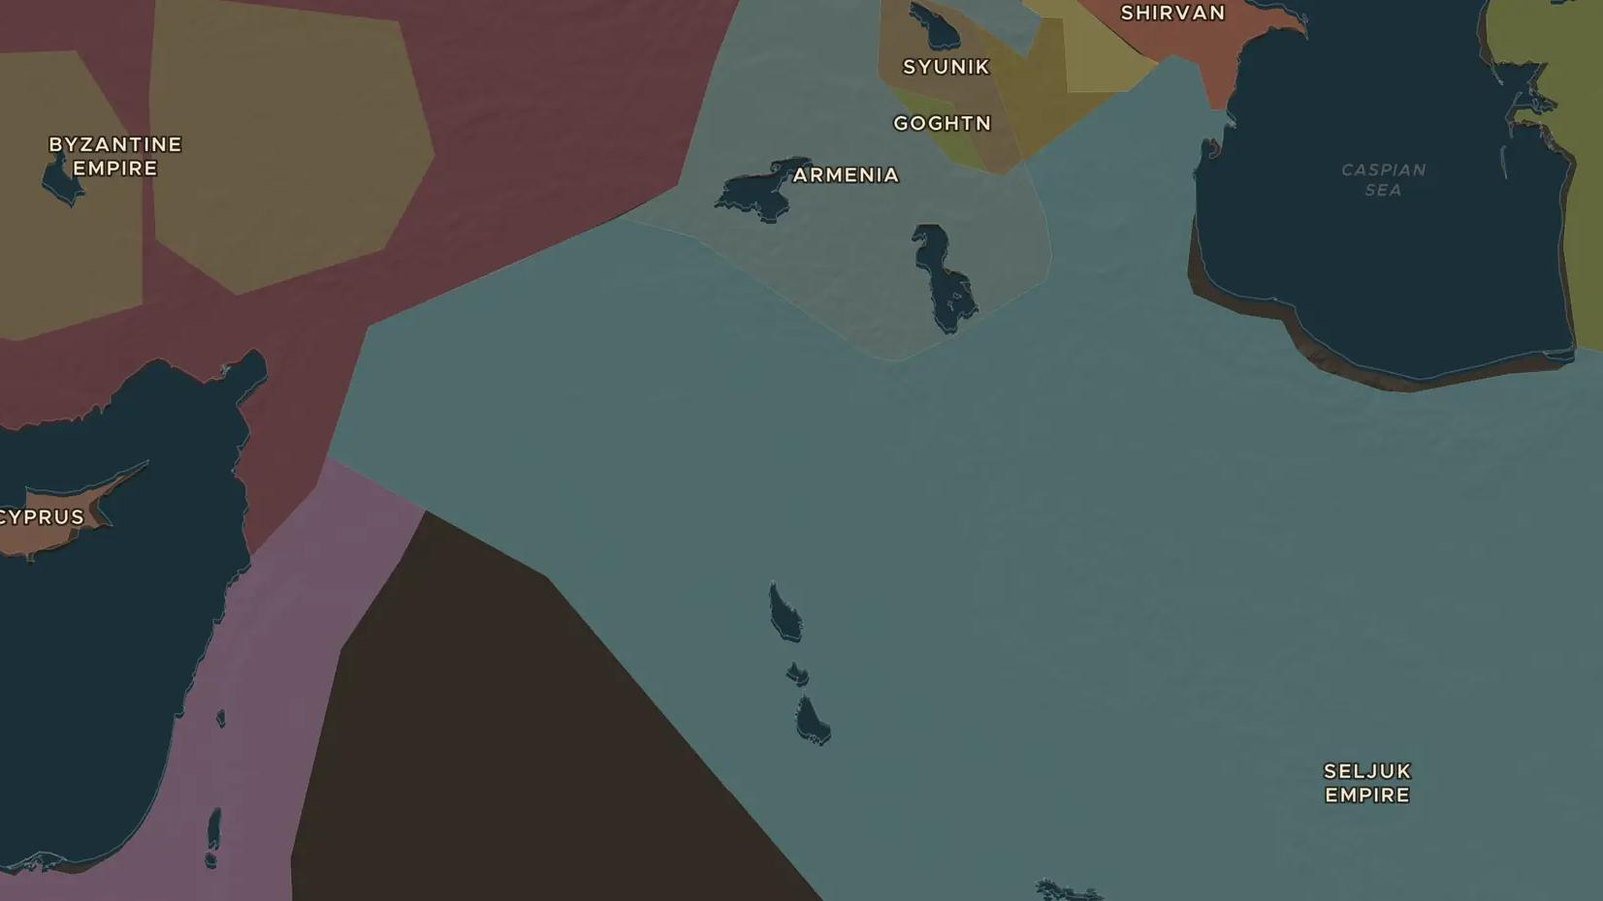
SELJUK EMPIRE · 1037-1092
The Seljuks and Manzikert
ChronoAtlas Classroom · Plate 229 · Ages 12-15 · 50 min
ChronoAtlas Classroom · chronoatlas.nl/classroom/lesson/seljuks-and-manzikert-1071

Slide 2
THIS LESSON
What students take from it
Turkish horsemen from Central Asia took over the heart of the Islamic world and beat a Byzantine emperor at Manzikert in 1071. Students explore how this opened Anatolia to the Turks and led to the Crusades.
LENGTH
50 min
AGES
12-15
ON THE MAP
BY THE END, STUDENTS CAN
3 steps, AD 1100
Trace the movement of the Seljuk Turks from Central Asia to Anatolia on the map.
Describe the Battle of Manzikert in 1071 and its results.
Explain the difference between a caliph and a sultan.
QUIZ
7 rounds
ChronoAtlas Classroom · chronoatlas.nl/classroom/lesson/seljuks-and-manzikert-1071
2

Slide 3
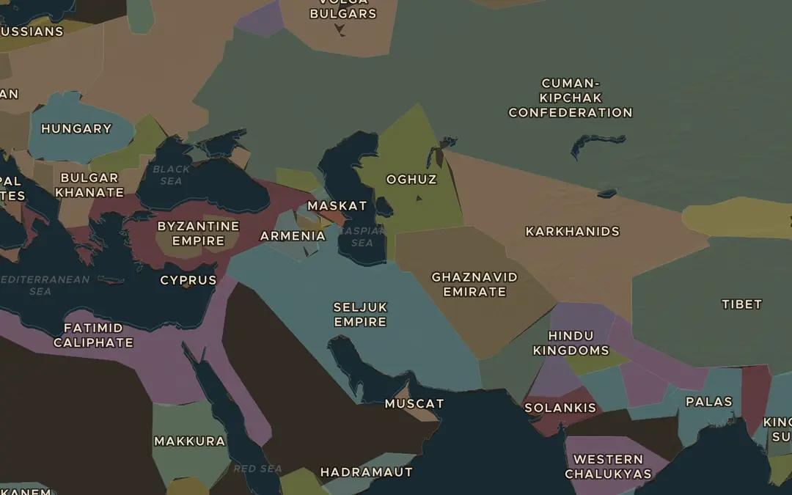
EXPLORE THE MAP · STEP A OF 3 · AD 1100
a
Turks from the steppe
Open the map in 1100 and find the Seljuk Empire. Then look to the north-east, near the Aral Sea: which Turkish people does the map show there, from whom the Seljuks came?
Open this view on the live map →
ChronoAtlas Classroom · chronoatlas.nl/classroom/lesson/seljuks-and-manzikert-1071
3
Notes:
Open the map in 1100 and find the Seljuk Empire. Then look to the north-east, near the Aral Sea: which Turkish people does the map show there, from whom the Seljuks came?
https://chronoatlas.nl/?year=1100&lat=38&lng=55&zoom=3.6

Slide 4
CHRONOATLAS CLASSROOM
The rest of this deck comes with Classroom
19 more slides: the other map steps, the discussion questions, the quiz with its answers, and the worksheet.
Every lesson as a deck, every worksheet, every live lesson and homework.
€19 a month, cancel anytime. The free lesson, Rome at its height, comes whole.
https://chronoatlas.nl/pricing
ChronoAtlas Classroom · chronoatlas.nl/classroom/lesson/seljuks-and-manzikert-1071
4

