Slide 1
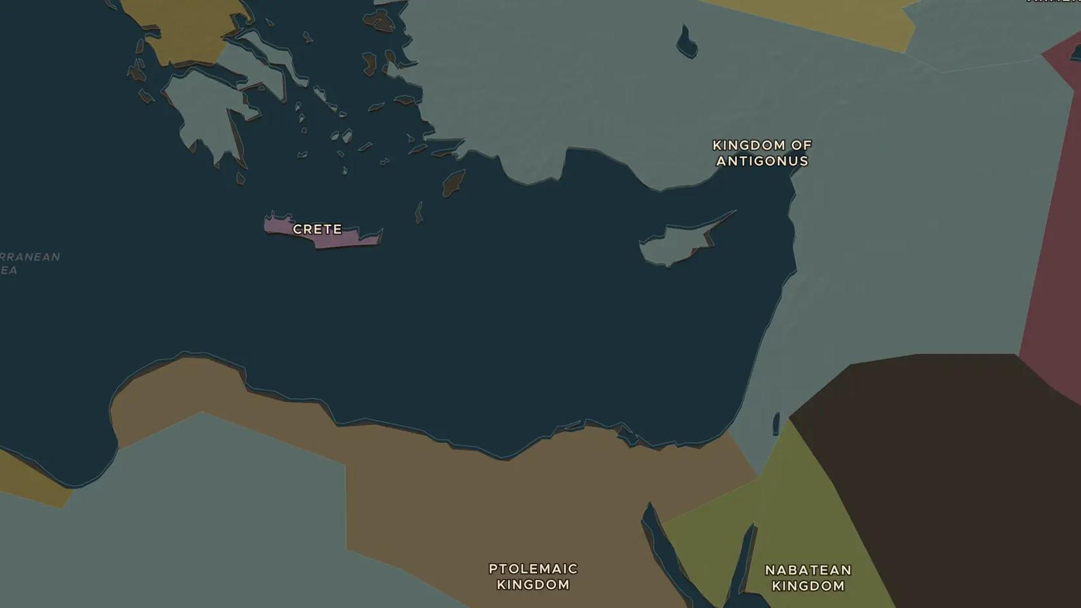
HELLENISTIC WORLD · 2560-280 BC
The Seven Wonders of the ancient world
ChronoAtlas Classroom · Plate 64 · Ages 10-13 · 45 min
ChronoAtlas Classroom · chronoatlas.nl/classroom/lesson/seven-wonders

Slide 2
THIS LESSON
What students take from it
Greek travelers in the Hellenistic age made a list of seven sights everyone should see. Students find all seven on the map, from the pyramid of Giza to the lighthouse of Alexandria, work out which ones they could still visit, and decide what makes something a wonder.
LENGTH
45 min
AGES
10-13
ON THE MAP
BY THE END, STUDENTS CAN
3 steps, 560 BC
Name the Seven Wonders and locate each on the map.
Order the wonders by age and say which still stands today.
Explain why the list was made by Greeks in the Hellenistic period and what it tells us about their world.
QUIZ
7 rounds
ChronoAtlas Classroom · chronoatlas.nl/classroom/lesson/seven-wonders
2

Slide 3
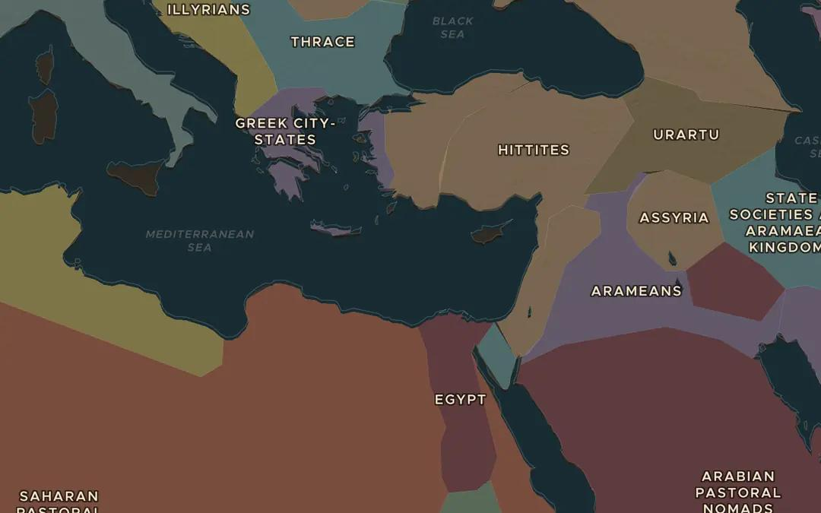
EXPLORE THE MAP · STEP A OF 3 · 560 BC
a
The oldest wonder
Open the map in 560 BC on the Aegean and turn on Historical Events (Cultural and Religious). The temple of Artemis at Ephesus was being rebuilt with gifts from Croesus of Lydia. Then travel to Giza: the Great Pyramid was already 2,000 years old when the Greeks saw it. Find both on the map.
Open this view on the live map →
ChronoAtlas Classroom · chronoatlas.nl/classroom/lesson/seven-wonders
3
Notes:
Open the map in 560 BC on the Aegean and turn on Historical Events (Cultural and Religious). The temple of Artemis at Ephesus was being rebuilt with gifts from Croesus of Lydia. Then travel to Giza: the Great Pyramid was already 2,000 years old when the Greeks saw it. Find both on the map.
https://chronoatlas.nl/?year=-560&lat=34&lng=29&zoom=4.5

Slide 4
CHRONOATLAS CLASSROOM
The rest of this deck comes with Classroom
19 more slides: the other map steps, the discussion questions, the quiz with its answers, and the worksheet.
Every lesson as a deck, every worksheet, every live lesson and homework.
€19 a month, cancel anytime. The free lesson, Rome at its height, comes whole.
https://chronoatlas.nl/pricing
ChronoAtlas Classroom · chronoatlas.nl/classroom/lesson/seven-wonders
4

