Slide 1
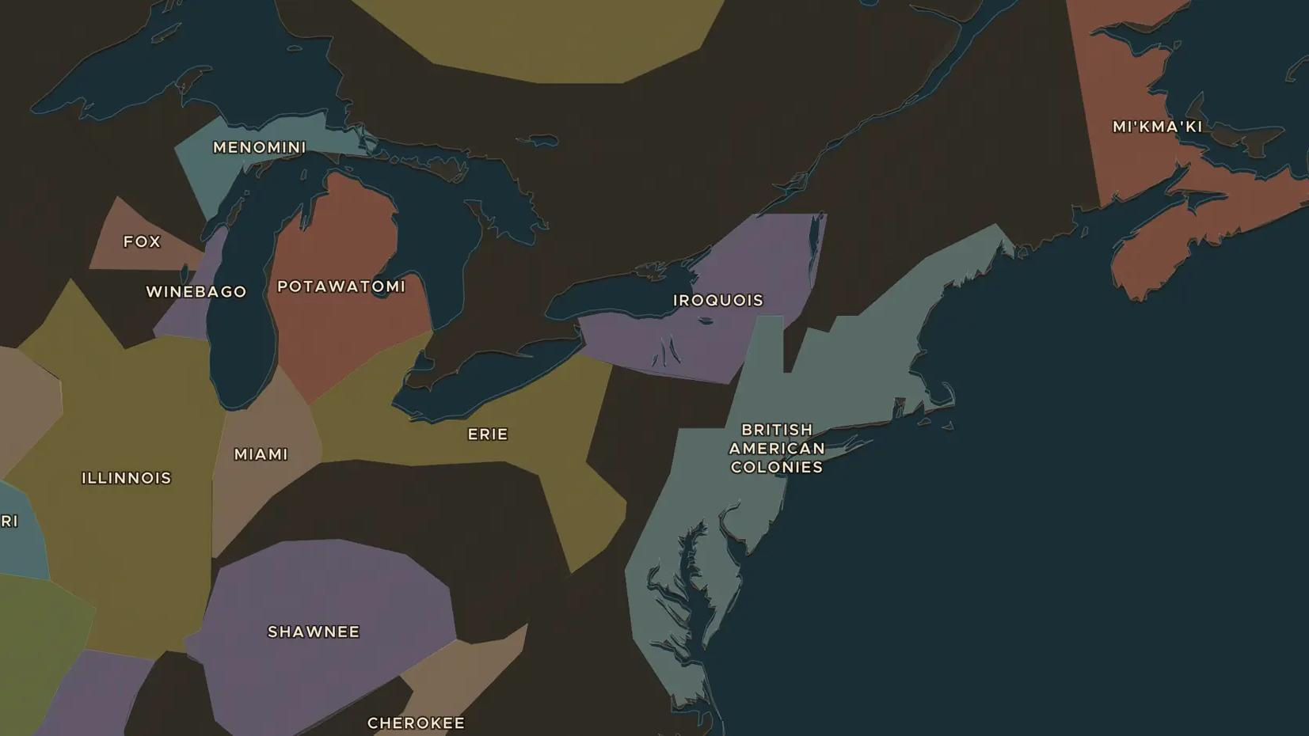
SEVEN YEARS' WAR · 1754-1763
1754-1763: the war that redrew North America
ChronoAtlas Classroom · Plate 383 · Ages 12-15 · 50 min
ChronoAtlas Classroom · chronoatlas.nl/classroom/lesson/seven-years-war-north-america

Slide 2
THIS LESSON
What students take from it
France and Britain fought for control of North America, and Native nations fought for their own lands between them. Students follow the war from the Ohio valley to Quebec, the peace of 1763 that removed France from the continent, and Pontiac's War that followed.
LENGTH
50 min
AGES
12-15
ON THE MAP
BY THE END, STUDENTS CAN
3 steps, AD 1748
Explain why France, Britain and Native nations all wanted the Ohio valley.
Locate the Forks of the Ohio, Quebec and Detroit and describe what happened at each.
Describe the results of 1763 for France, Britain and Native nations.
QUIZ
7 rounds
ChronoAtlas Classroom · chronoatlas.nl/classroom/lesson/seven-years-war-north-america
2

Slide 3
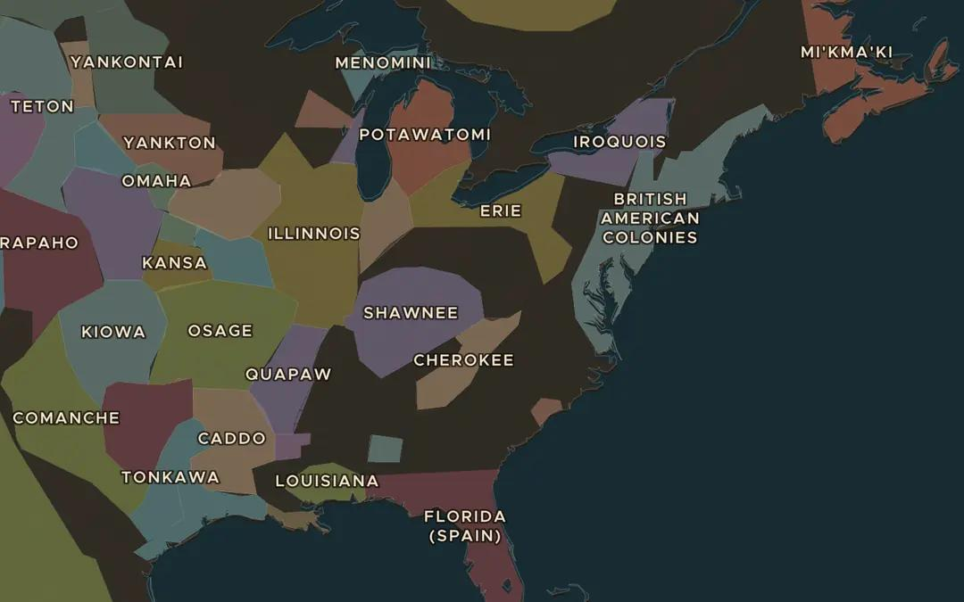
EXPLORE THE MAP · STEP A OF 3 · AD 1748
a
Before the war
Open the map in 1748. Find the British American colonies along the Atlantic coast and Louisiana on the Gulf of Mexico. Then look at the land west of the Appalachian Mountains. Which Native nations lived there?
Open this view on the live map →
ChronoAtlas Classroom · chronoatlas.nl/classroom/lesson/seven-years-war-north-america
3
Notes:
Open the map in 1748. Find the British American colonies along the Atlantic coast and Louisiana on the Gulf of Mexico. Then look at the land west of the Appalachian Mountains. Which Native nations lived there?
https://chronoatlas.nl/?year=1748&lat=38&lng=-82&zoom=4.5

Slide 4
CHRONOATLAS CLASSROOM
The rest of this deck comes with Classroom
19 more slides: the other map steps, the discussion questions, the quiz with its answers, and the worksheet.
Every lesson as a deck, every worksheet, every live lesson and homework.
€19 a month, cancel anytime. The free lesson, Rome at its height, comes whole.
https://chronoatlas.nl/pricing
ChronoAtlas Classroom · chronoatlas.nl/classroom/lesson/seven-years-war-north-america
4

