Slide 1
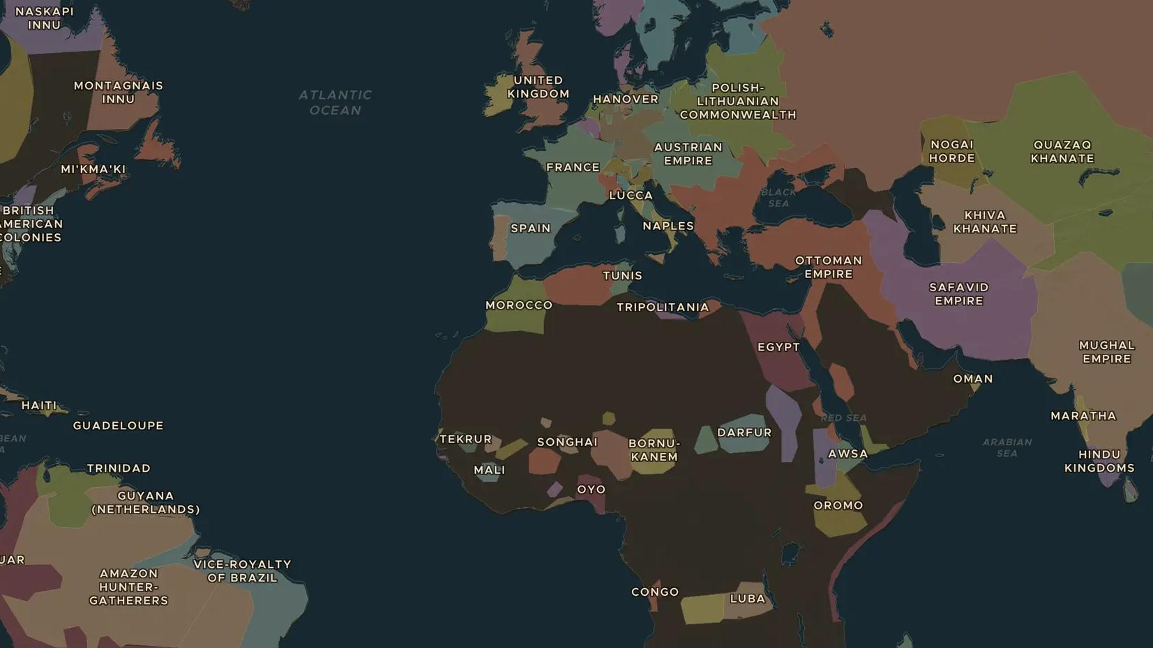
GLOBAL EMPIRES · 1756-1763
The Seven Years' War: a war around the world
ChronoAtlas Classroom · Plate 373 · Ages 13-16 · 50 min
ChronoAtlas Classroom · chronoatlas.nl/classroom/lesson/seven-years-war-world-war

Slide 2
THIS LESSON
What students take from it
Britain and France fight in Europe, North America, the Caribbean, West Africa and India at the same time. Students follow the war from the Ohio valley to Quebec and Plassey, and see how the Peace of Paris of 1763 redrew the map of empires.
LENGTH
50 min
AGES
13-16
ON THE MAP
BY THE END, STUDENTS CAN
3 steps, AD 1700
Explain why the Seven Years' War is often called the first world war.
Locate Quebec, Plassey and the Ohio valley and explain what happened there.
Describe how the Peace of Paris (1763) changed the empires of Britain, France and Spain.
QUIZ
7 rounds
ChronoAtlas Classroom · chronoatlas.nl/classroom/lesson/seven-years-war-world-war
2

Slide 3
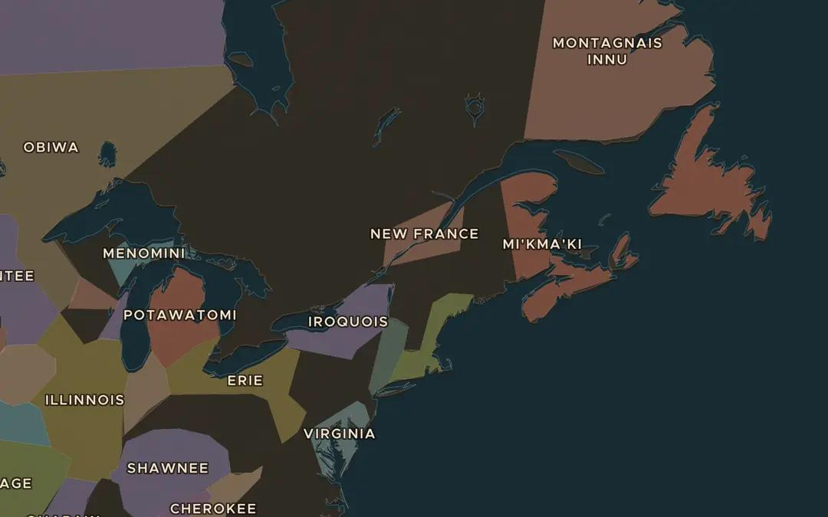
EXPLORE THE MAP · STEP A OF 3 · AD 1700
a
New France
Open the map in 1700 and look at North America. Find New France along the St Lawrence river. Then jump to 1783: is it still there?
Open this view on the live map →
ChronoAtlas Classroom · chronoatlas.nl/classroom/lesson/seven-years-war-world-war
3
Notes:
Open the map in 1700 and look at North America. Find New France along the St Lawrence river. Then jump to 1783: is it still there?
https://chronoatlas.nl/?year=1700&lat=46&lng=-72&zoom=4.5

Slide 4
CHRONOATLAS CLASSROOM
The rest of this deck comes with Classroom
19 more slides: the other map steps, the discussion questions, the quiz with its answers, and the worksheet.
Every lesson as a deck, every worksheet, every live lesson and homework.
€19 a month, cancel anytime. The free lesson, Rome at its height, comes whole.
https://chronoatlas.nl/pricing
ChronoAtlas Classroom · chronoatlas.nl/classroom/lesson/seven-years-war-world-war
4

