Slide 1
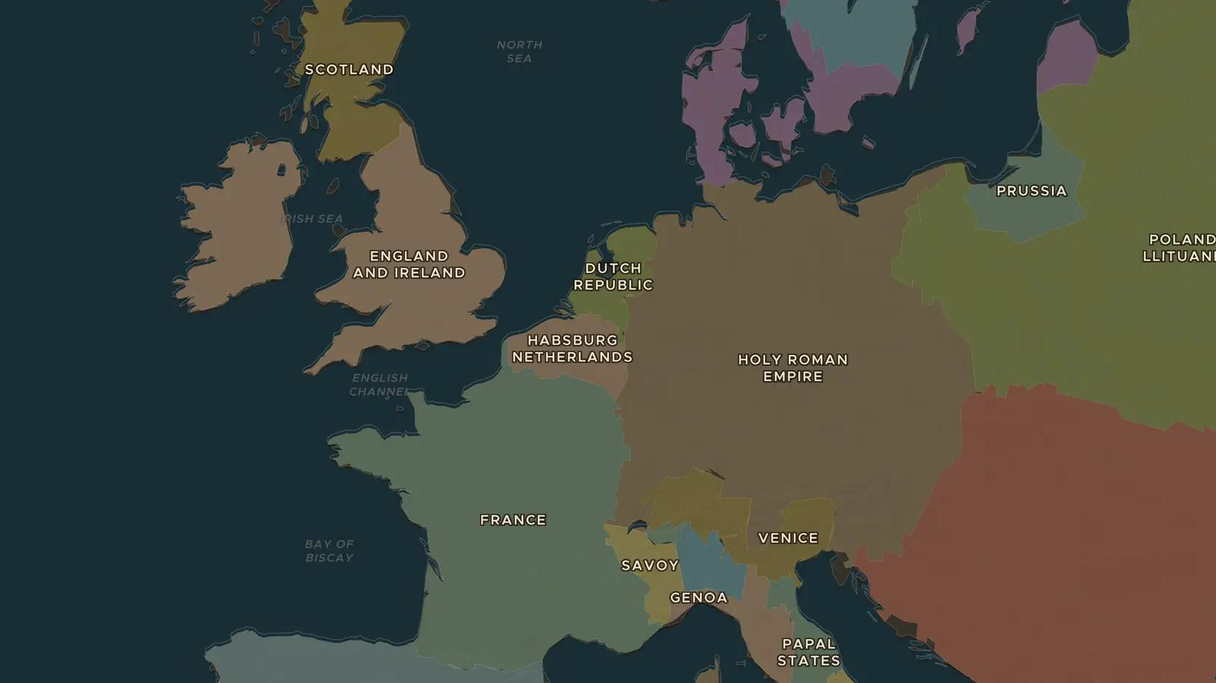
ELIZABETHAN ENGLAND · 1590-1616
Shakespeare's London
ChronoAtlas Classroom · Plate 343 · Ages 11-14 · 45 min
ChronoAtlas Classroom · chronoatlas.nl/classroom/lesson/shakespeare-globe-london

Slide 2
THIS LESSON
What students take from it
A glover's son from Stratford becomes the most famous playwright in the world. Students explore the crowded London of the Globe Theatre, where courtiers, apprentices and pickpockets watched the same plays, and ask why theatre was so popular.
LENGTH
45 min
AGES
11-14
ON THE MAP
BY THE END, STUDENTS CAN
3 steps, AD 1600
Describe what a visit to the Globe Theatre was like around 1600.
Locate Stratford-upon-Avon, London and two foreign settings of Shakespeare's plays.
Explain why theatre was popular, and why some people opposed it.
QUIZ
7 rounds
ChronoAtlas Classroom · chronoatlas.nl/classroom/lesson/shakespeare-globe-london
2

Slide 3
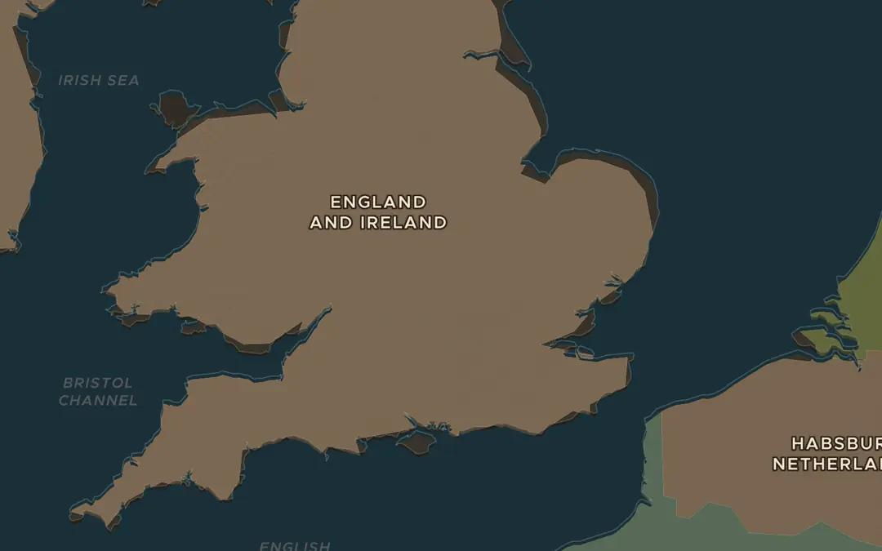
EXPLORE THE MAP · STEP A OF 3 · AD 1600
a
From Stratford to London
Open the map in 1600 and zoom in on England. Find Stratford-upon-Avon in the Midlands and London on the Thames. How long might the journey of about 150 km take on foot or on horseback?
Open this view on the live map →
ChronoAtlas Classroom · chronoatlas.nl/classroom/lesson/shakespeare-globe-london
3
Notes:
Open the map in 1600 and zoom in on England. Find Stratford-upon-Avon in the Midlands and London on the Thames. How long might the journey of about 150 km take on foot or on horseback?
https://chronoatlas.nl/?year=1600&lat=52&lng=-1&zoom=6.5

Slide 4
CHRONOATLAS CLASSROOM
The rest of this deck comes with Classroom
19 more slides: the other map steps, the discussion questions, the quiz with its answers, and the worksheet.
Every lesson as a deck, every worksheet, every live lesson and homework.
€19 a month, cancel anytime. The free lesson, Rome at its height, comes whole.
https://chronoatlas.nl/pricing
ChronoAtlas Classroom · chronoatlas.nl/classroom/lesson/shakespeare-globe-london
4

