Slide 1
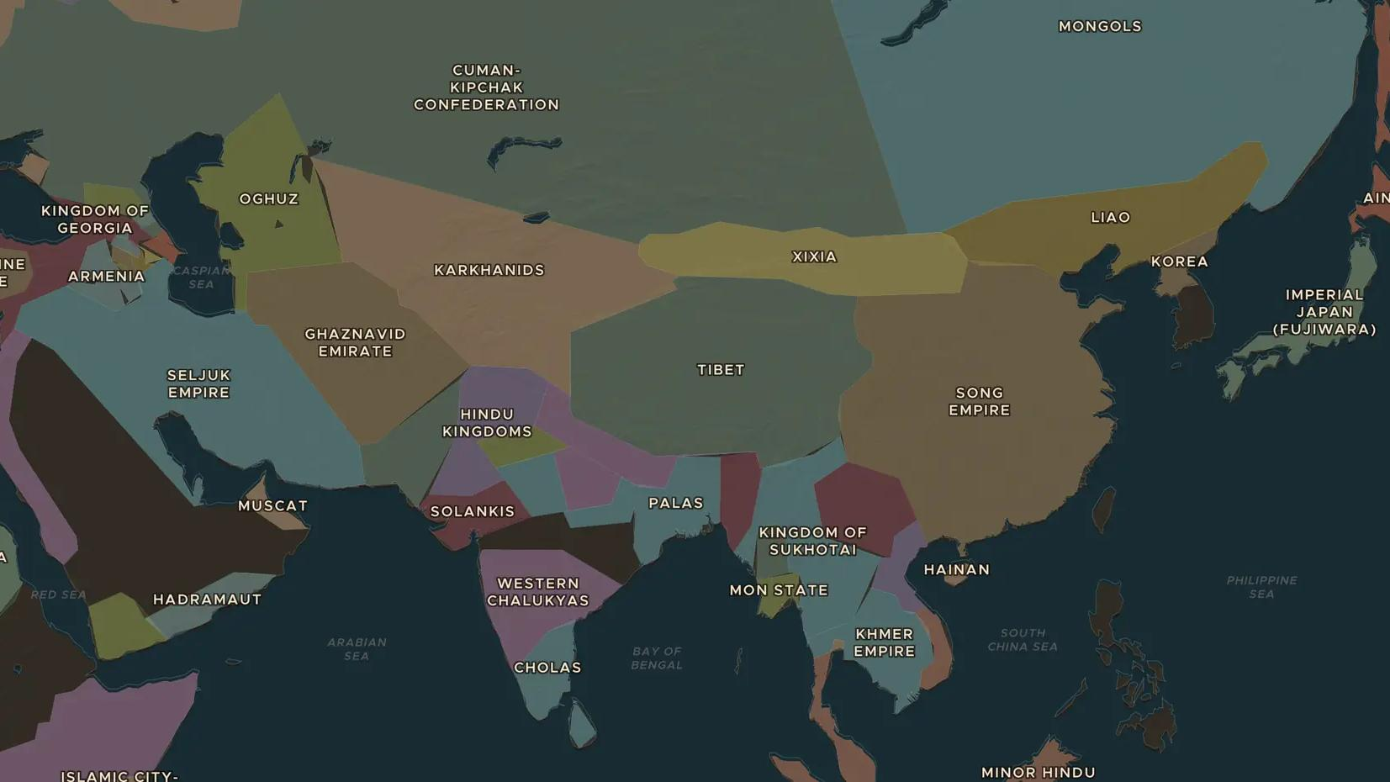
SONG DYNASTY · 960-1279
Song China: printing, compass and gunpowder
ChronoAtlas Classroom · Plate 228 · Ages 10-13 · 50 min
ChronoAtlas Classroom · chronoatlas.nl/classroom/lesson/song-dynasty-inventions

Slide 2
THIS LESSON
What students take from it
Under the Song dynasty, China printed books with movable type, steered ships by compass and wrote down the first recipe for gunpowder. Students explore the inventions and ask why they changed the world so slowly.
LENGTH
50 min
AGES
10-13
ON THE MAP
BY THE END, STUDENTS CAN
3 steps, AD 1100
Name three Song inventions or improvements and explain what each was used for.
Explain how printing helped the Song civil service exams and spread knowledge.
Compare Bi Sheng's movable type with the later printing press in Europe.
QUIZ
7 rounds
ChronoAtlas Classroom · chronoatlas.nl/classroom/lesson/song-dynasty-inventions
2

Slide 3
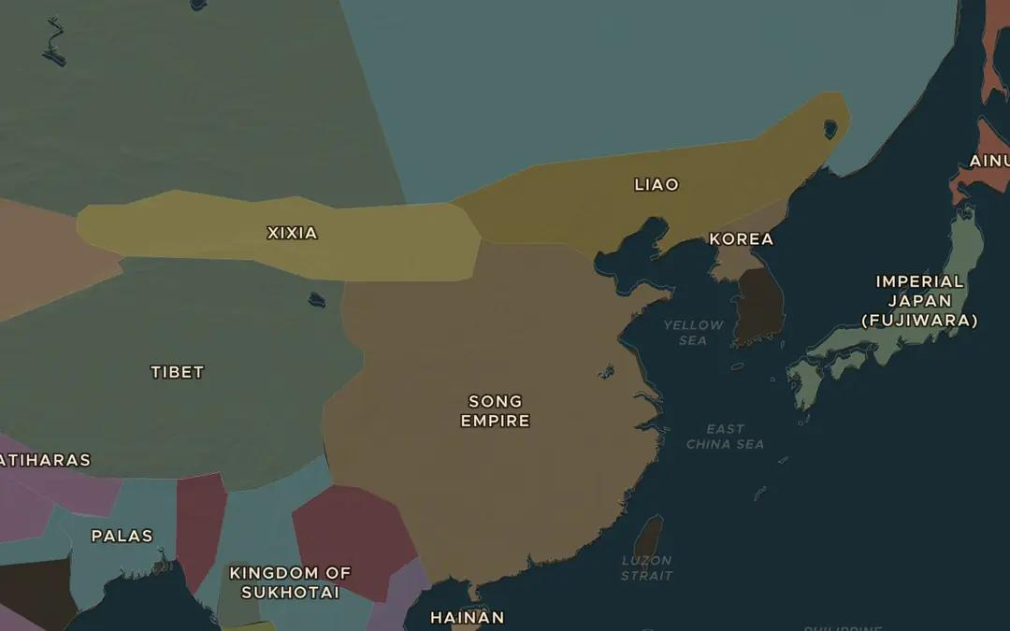
EXPLORE THE MAP · STEP A OF 3 · AD 1100
a
Song and its neighbours
Open the map in 1100. Find the Song Empire and its northern neighbours, the Liao and the Xixia. Why would the Song need strong new weapons on this border?
Open this view on the live map →
ChronoAtlas Classroom · chronoatlas.nl/classroom/lesson/song-dynasty-inventions
3
Notes:
Open the map in 1100. Find the Song Empire and its northern neighbours, the Liao and the Xixia. Why would the Song need strong new weapons on this border?
https://chronoatlas.nl/?year=1100&lat=36&lng=112&zoom=4

Slide 4
CHRONOATLAS CLASSROOM
The rest of this deck comes with Classroom
19 more slides: the other map steps, the discussion questions, the quiz with its answers, and the worksheet.
Every lesson as a deck, every worksheet, every live lesson and homework.
€19 a month, cancel anytime. The free lesson, Rome at its height, comes whole.
https://chronoatlas.nl/pricing
ChronoAtlas Classroom · chronoatlas.nl/classroom/lesson/song-dynasty-inventions
4

