Slide 1
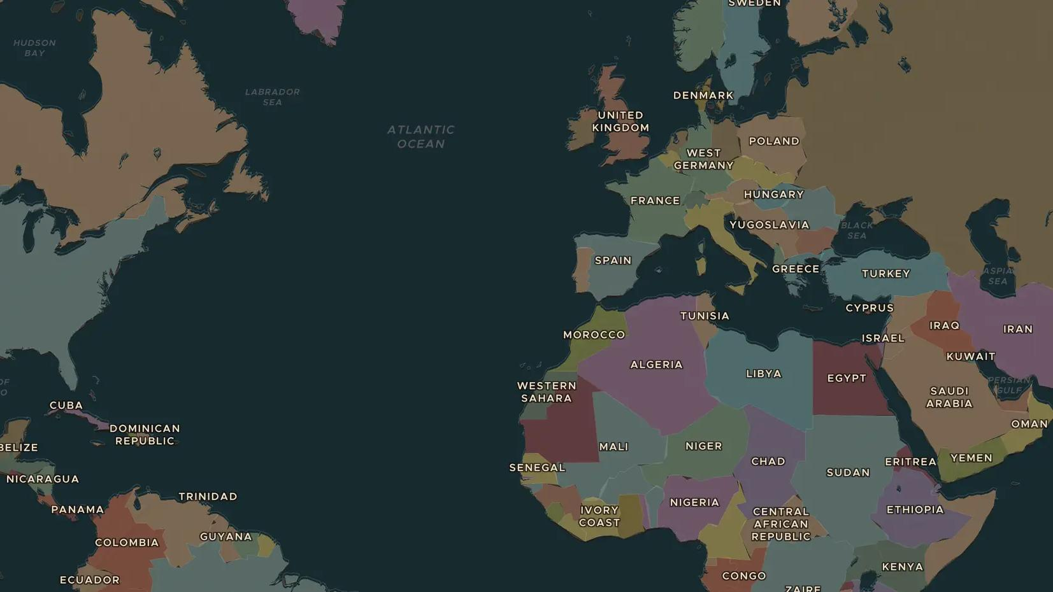
COLD WAR · 1957-1969
The space race
ChronoAtlas Classroom · Plate 509 · Ages 11-14 · 45 min
ChronoAtlas Classroom · chronoatlas.nl/classroom/lesson/space-race

Slide 2
THIS LESSON
What students take from it
In 1957 the Soviet Union launched Sputnik, the first satellite. Twelve years later two Americans walked on the Moon. Students find the launch sites on the map, keep score of the "firsts" and ask how a Cold War rivalry pushed people into space.
LENGTH
45 min
AGES
11-14
ON THE MAP
BY THE END, STUDENTS CAN
3 steps, AD 1960
Explain why the United States and the Soviet Union raced each other into space.
Name the main "firsts" of the space race and who achieved them.
Locate the launch sites at Baikonur and Cape Canaveral and explain why they were placed there.
QUIZ
7 rounds
ChronoAtlas Classroom · chronoatlas.nl/classroom/lesson/space-race
2

Slide 3
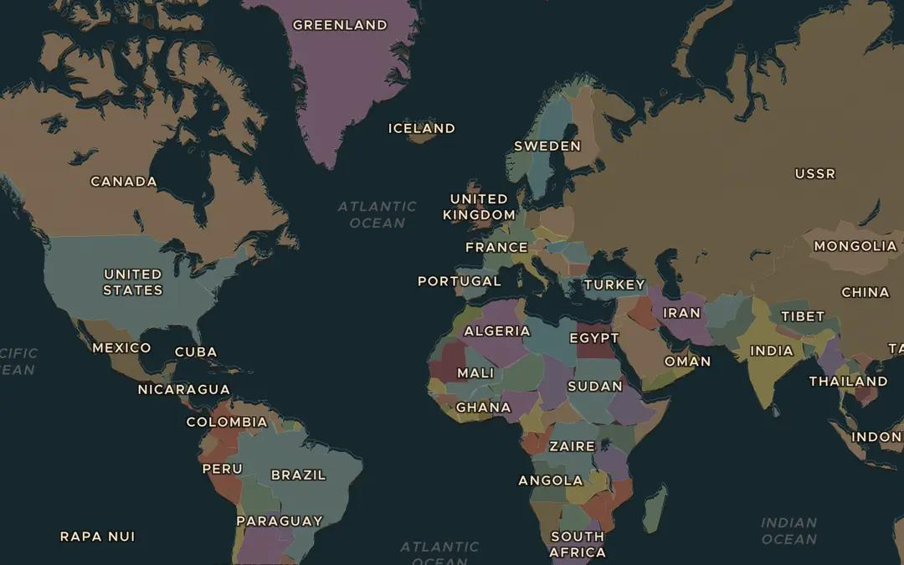
EXPLORE THE MAP · STEP A OF 3 · AD 1960
a
Two launch sites
Open the map in 1960 and zoom out. Find the steppe of Kazakhstan in the southern USSR and the coast of Florida in the United States. Ask the atlas: "Where did Soviet and American space rockets take off?"
Open this view on the live map →
ChronoAtlas Classroom · chronoatlas.nl/classroom/lesson/space-race
3
Notes:
Open the map in 1960 and zoom out. Find the steppe of Kazakhstan in the southern USSR and the coast of Florida in the United States. Ask the atlas: "Where did Soviet and American space rockets take off?"
https://chronoatlas.nl/?year=1960&lat=40&lng=-10&zoom=2

Slide 4
CHRONOATLAS CLASSROOM
The rest of this deck comes with Classroom
19 more slides: the other map steps, the discussion questions, the quiz with its answers, and the worksheet.
Every lesson as a deck, every worksheet, every live lesson and homework.
€19 a month, cancel anytime. The free lesson, Rome at its height, comes whole.
https://chronoatlas.nl/pricing
ChronoAtlas Classroom · chronoatlas.nl/classroom/lesson/space-race
4

