Slide 1
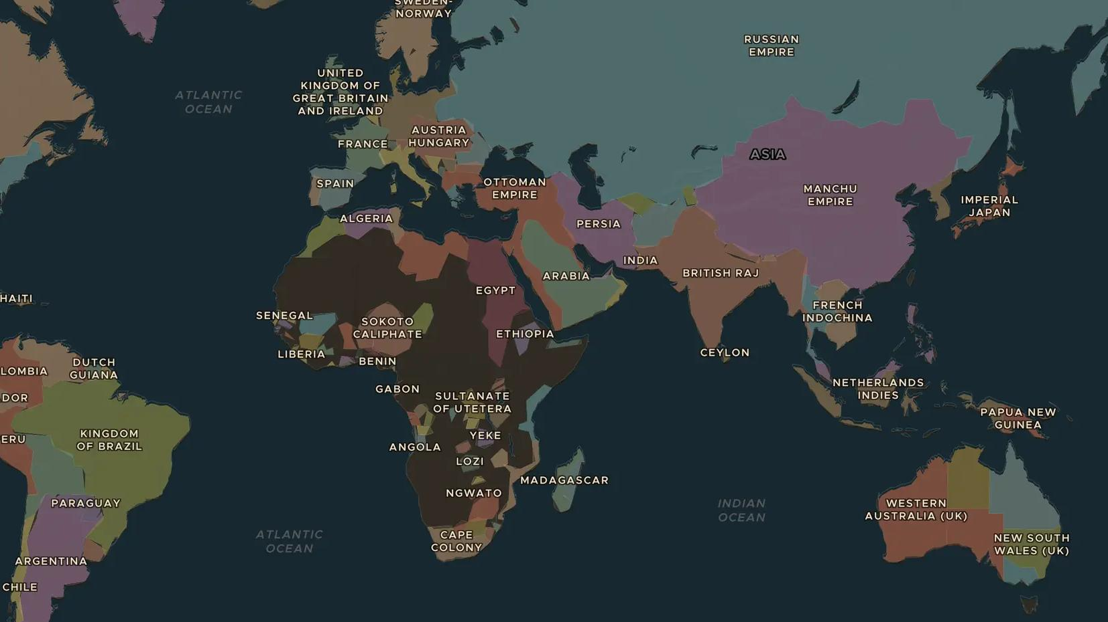
AGE OF EMPIRE · 1868-1902
1898: Cuba, the Philippines and the end of Spain's empire
ChronoAtlas Classroom · Plate 438 · Ages 13-16 · 50 min
ChronoAtlas Classroom · chronoatlas.nl/classroom/lesson/spain-loses-empire-1898

Slide 2
THIS LESSON
What students take from it
Cubans and Filipinos fight for independence from Spain. In 1898 the United States joins in, wins a short war and takes Spain's last colonies. Students ask whether 1898 brought liberation or a new kind of empire.
LENGTH
50 min
AGES
13-16
ON THE MAP
BY THE END, STUDENTS CAN
3 steps, AD 1880
Describe the independence struggles in Cuba and the Philippines before 1898.
Explain the causes and results of the Spanish-American War of 1898.
Debate whether the United States became an empire after 1898.
QUIZ
7 rounds
ChronoAtlas Classroom · chronoatlas.nl/classroom/lesson/spain-loses-empire-1898
2

Slide 3
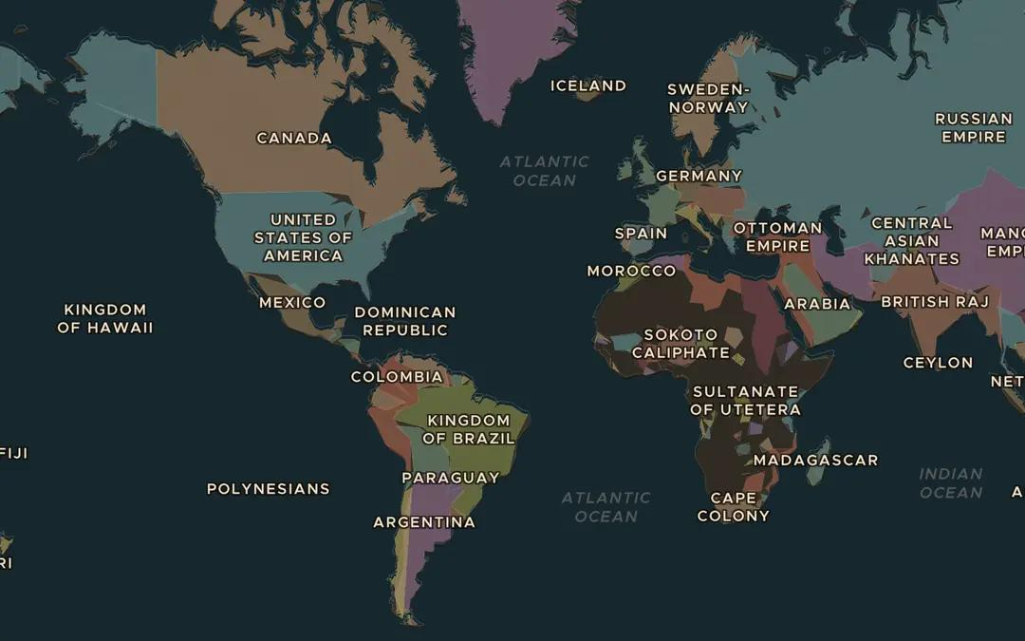
EXPLORE THE MAP · STEP A OF 3 · AD 1880
a
Spain's last colonies
Open the map in 1880 and find Cuba, Puerto Rico and the Philippines, Spain's last large colonies. Roughly how far is each of them from Madrid?
Open this view on the live map →
ChronoAtlas Classroom · chronoatlas.nl/classroom/lesson/spain-loses-empire-1898
3
Notes:
Open the map in 1880 and find Cuba, Puerto Rico and the Philippines, Spain's last large colonies. Roughly how far is each of them from Madrid?
https://chronoatlas.nl/?year=1880&lat=20&lng=-40&zoom=1.8

Slide 4
CHRONOATLAS CLASSROOM
The rest of this deck comes with Classroom
19 more slides: the other map steps, the discussion questions, the quiz with its answers, and the worksheet.
Every lesson as a deck, every worksheet, every live lesson and homework.
€19 a month, cancel anytime. The free lesson, Rome at its height, comes whole.
https://chronoatlas.nl/pricing
ChronoAtlas Classroom · chronoatlas.nl/classroom/lesson/spain-loses-empire-1898
4

