Slide 1
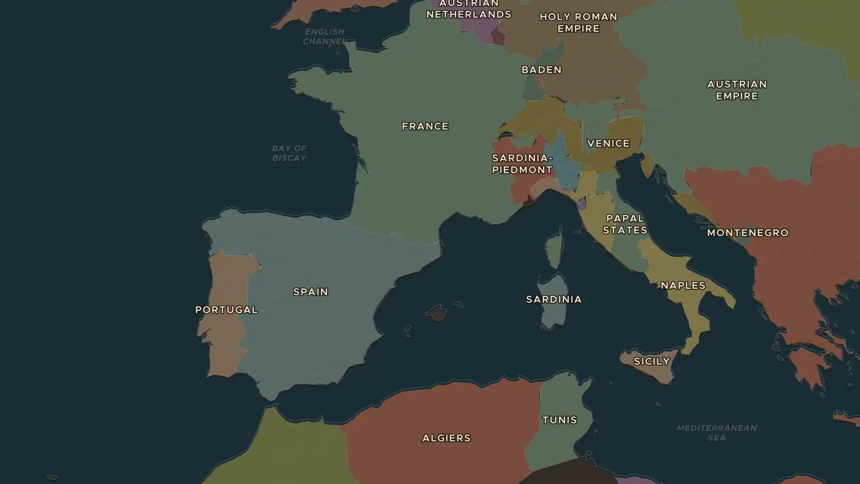
AGE OF LOUIS XIV · 1701-1714
The War of the Spanish Succession
ChronoAtlas Classroom · Plate 374 · Ages 13-16 · 45 min
ChronoAtlas Classroom · chronoatlas.nl/classroom/lesson/spanish-succession-utrecht

Slide 2
THIS LESSON
What students take from it
When the childless king of Spain dies in 1700, he leaves his empire to a grandson of Louis XIV. Much of Europe goes to war to stop France and Spain from joining. Students follow the war from Blenheim to Gibraltar and Barcelona, and see who gained what at Utrecht in 1713.
LENGTH
45 min
AGES
13-16
ON THE MAP
BY THE END, STUDENTS CAN
3 steps, AD 1700
Explain why the death of Charles II of Spain in 1700 led to a European war.
Locate Blenheim, Gibraltar, Barcelona and Utrecht and explain their role.
Describe what Britain, Austria and Philip V gained in the peace of 1713-1714.
QUIZ
7 rounds
ChronoAtlas Classroom · chronoatlas.nl/classroom/lesson/spanish-succession-utrecht
2

Slide 3
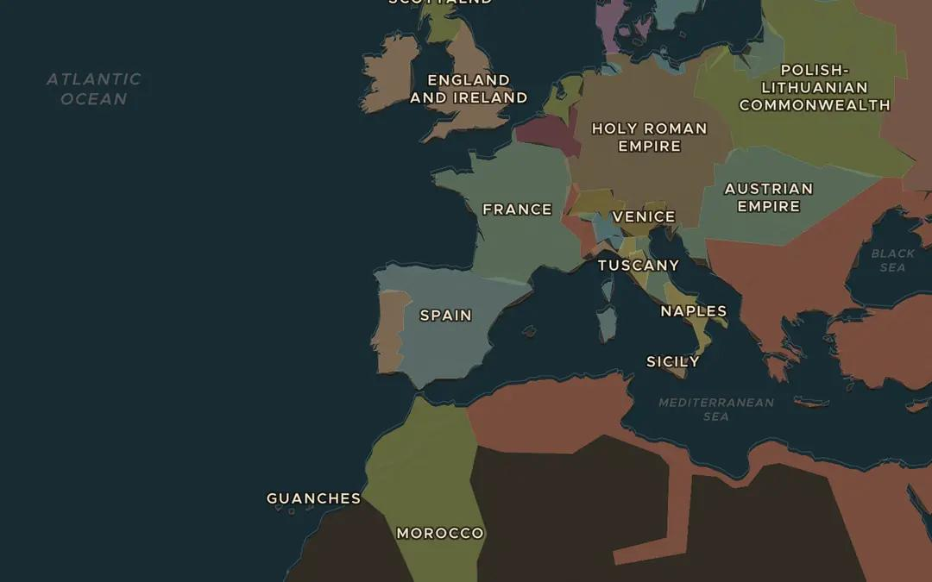
EXPLORE THE MAP · STEP A OF 3 · AD 1700
a
A huge inheritance
Open the map in 1700 and find Spain and its lands in Italy and the Americas. Then find France next door. Why did other powers fear one family ruling both?
Open this view on the live map →
ChronoAtlas Classroom · chronoatlas.nl/classroom/lesson/spanish-succession-utrecht
3
Notes:
Open the map in 1700 and find Spain and its lands in Italy and the Americas. Then find France next door. Why did other powers fear one family ruling both?
https://chronoatlas.nl/?year=1700&lat=42&lng=-2&zoom=3.8

Slide 4
CHRONOATLAS CLASSROOM
The rest of this deck comes with Classroom
19 more slides: the other map steps, the discussion questions, the quiz with its answers, and the worksheet.
Every lesson as a deck, every worksheet, every live lesson and homework.
€19 a month, cancel anytime. The free lesson, Rome at its height, comes whole.
https://chronoatlas.nl/pricing
ChronoAtlas Classroom · chronoatlas.nl/classroom/lesson/spanish-succession-utrecht
4

