Slide 1
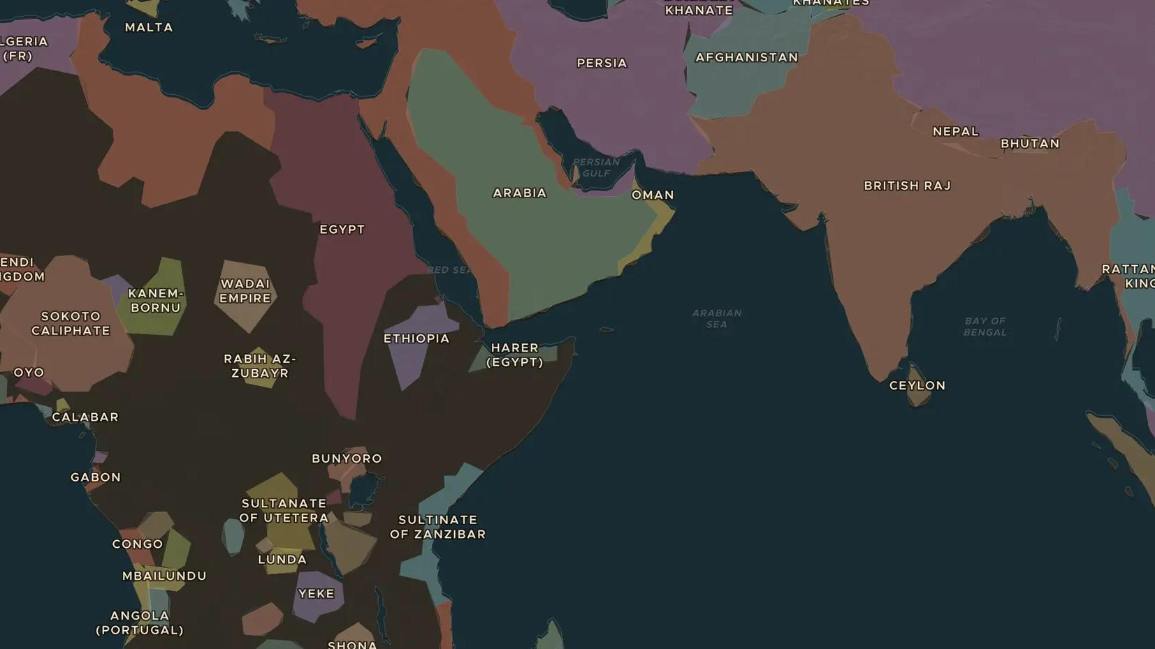
AGE OF EMPIRE · 1859-1882
The Suez Canal
ChronoAtlas Classroom · Plate 422 · Ages 11-14 · 45 min
ChronoAtlas Classroom · chronoatlas.nl/classroom/lesson/suez-canal

Slide 2
THIS LESSON
What students take from it
In ten years, tens of thousands of Egyptian workers dig a canal between the Mediterranean and the Red Sea. The sea route from Europe to Asia shrinks by thousands of kilometres, and Egypt falls into debt and foreign control. Students ask who really gained from the canal.
LENGTH
45 min
AGES
11-14
ON THE MAP
BY THE END, STUDENTS CAN
3 steps, AD 1840
Explain how the Suez Canal was built and why it mattered for world trade.
Compare the sea routes from Europe to Asia before and after 1869.
Explain how the canal led to debt and the British occupation of Egypt in 1882.
QUIZ
7 rounds
ChronoAtlas Classroom · chronoatlas.nl/classroom/lesson/suez-canal
2

Slide 3
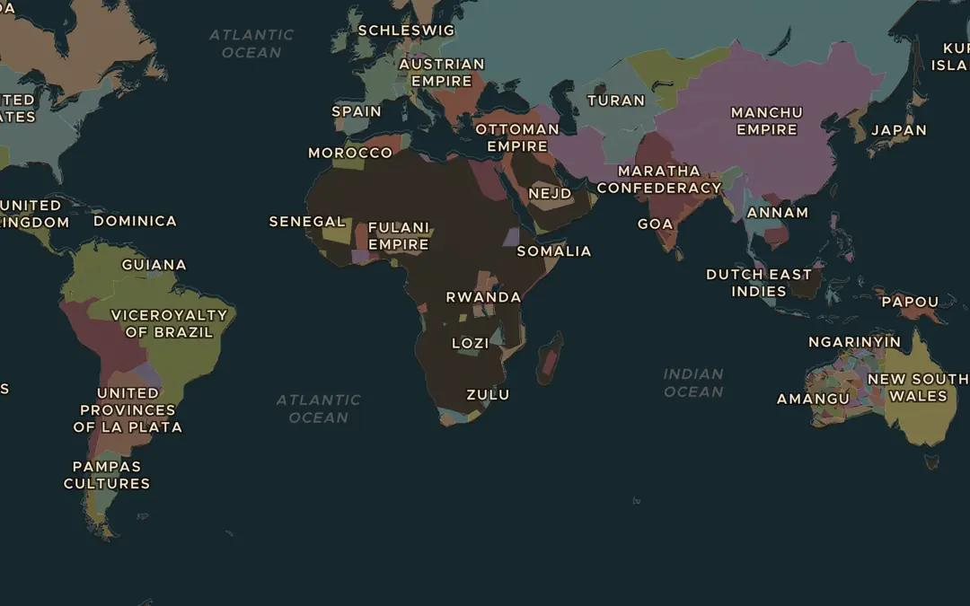
EXPLORE THE MAP · STEP A OF 3 · AD 1840
a
Before the canal
Open the map in 1840 and turn on Trade Routes. Follow the Cape Route to the Indies around Africa. How many weeks do you think that voyage took by sailing ship?
Open this view on the live map →
ChronoAtlas Classroom · chronoatlas.nl/classroom/lesson/suez-canal
3
Notes:
Open the map in 1840 and turn on Trade Routes. Follow the Cape Route to the Indies around Africa. How many weeks do you think that voyage took by sailing ship?
https://chronoatlas.nl/?year=1840&lat=-5&lng=30&zoom=2

Slide 4
CHRONOATLAS CLASSROOM
The rest of this deck comes with Classroom
19 more slides: the other map steps, the discussion questions, the quiz with its answers, and the worksheet.
Every lesson as a deck, every worksheet, every live lesson and homework.
€19 a month, cancel anytime. The free lesson, Rome at its height, comes whole.
https://chronoatlas.nl/pricing
ChronoAtlas Classroom · chronoatlas.nl/classroom/lesson/suez-canal
4

