Slide 1
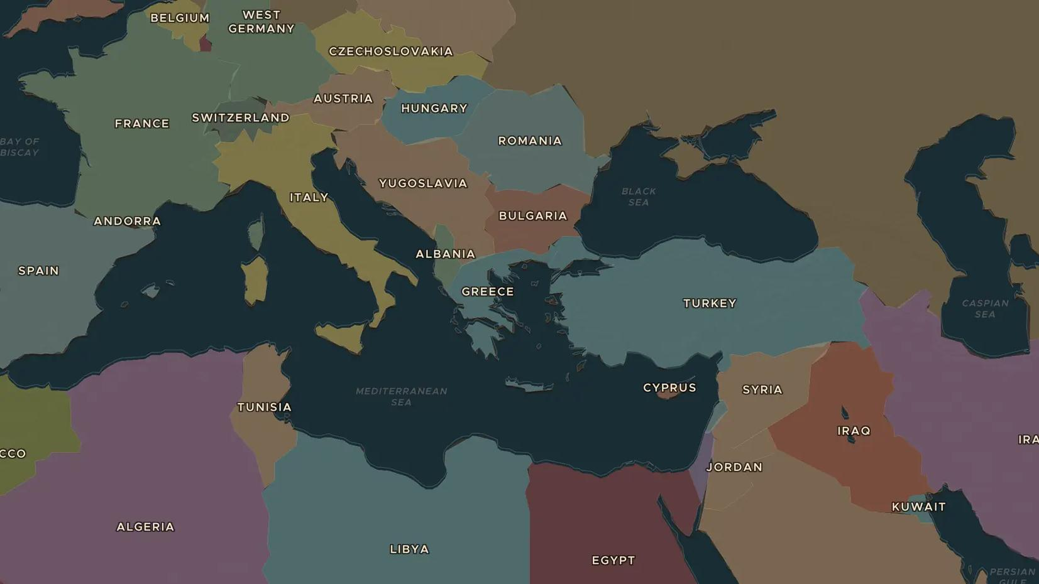
COLD WAR · 1956
1956: Suez and Hungary
ChronoAtlas Classroom · Plate 497 · Ages 13-16 · 50 min
ChronoAtlas Classroom · chronoatlas.nl/classroom/lesson/suez-hungary-1956

Slide 2
THIS LESSON
What students take from it
In the same weeks of 1956, Britain, France and Israel attacked Egypt over the Suez Canal, and Soviet tanks crushed a revolution in Hungary. Students follow both crises on the map and discover what they revealed about the real superpowers.
LENGTH
50 min
AGES
13-16
ON THE MAP
BY THE END, STUDENTS CAN
3 steps, AD 1960
Explain why Nasser nationalized the Suez Canal and why Britain, France and Israel attacked Egypt.
Describe the Hungarian uprising of 1956 and why the Soviet Union crushed it.
Explain what 1956 showed about the power of the United States and the Soviet Union.
QUIZ
7 rounds
ChronoAtlas Classroom · chronoatlas.nl/classroom/lesson/suez-hungary-1956
2

Slide 3
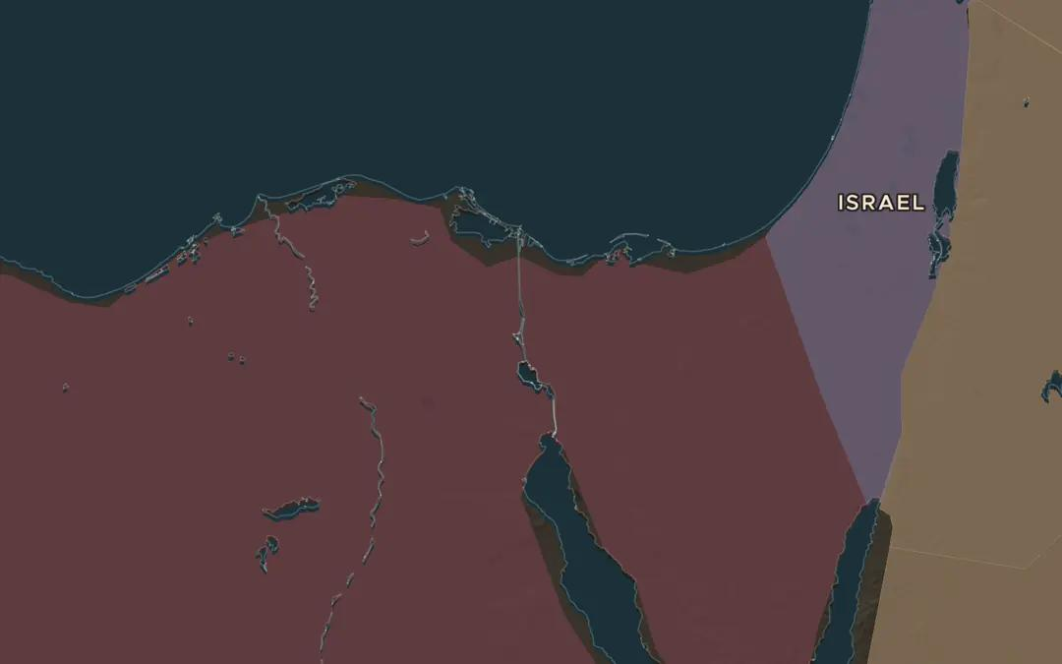
EXPLORE THE MAP · STEP A OF 3 · AD 1960
a
The canal
Open the map in 1960 and zoom in on the Suez Canal from Port Said to Suez. Which two seas does it join? Ask the atlas: "Why was the Suez Canal so important in 1956?"
Open this view on the live map →
ChronoAtlas Classroom · chronoatlas.nl/classroom/lesson/suez-hungary-1956
3
Notes:
Open the map in 1960 and zoom in on the Suez Canal from Port Said to Suez. Which two seas does it join? Ask the atlas: "Why was the Suez Canal so important in 1956?"
https://chronoatlas.nl/?year=1960&lat=30.6&lng=32.4&zoom=7

Slide 4
CHRONOATLAS CLASSROOM
The rest of this deck comes with Classroom
19 more slides: the other map steps, the discussion questions, the quiz with its answers, and the worksheet.
Every lesson as a deck, every worksheet, every live lesson and homework.
€19 a month, cancel anytime. The free lesson, Rome at its height, comes whole.
https://chronoatlas.nl/pricing
ChronoAtlas Classroom · chronoatlas.nl/classroom/lesson/suez-hungary-1956
4

