Slide 1
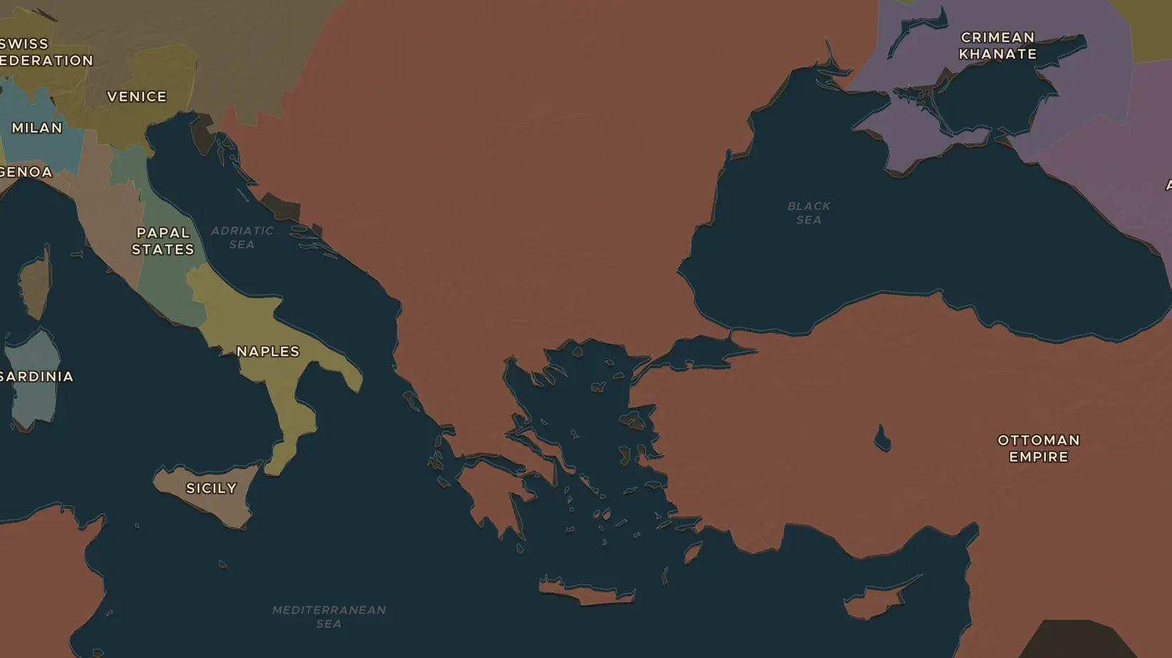
OTTOMAN EMPIRE · 1520-1566
Suleiman the Magnificent and Sinan
ChronoAtlas Classroom · Plate 338 · Ages 11-14 · 50 min
ChronoAtlas Classroom · chronoatlas.nl/classroom/lesson/suleiman-the-magnificent-and-sinan

Slide 2
THIS LESSON
What students take from it
Europe called him "the Magnificent", his own people "the Lawgiver". Students explore the reign of Suleiman, his campaigns from Belgrade to Baghdad, and the buildings of his architect Sinan.
LENGTH
50 min
AGES
11-14
ON THE MAP
BY THE END, STUDENTS CAN
3 steps, AD 1566
Describe the extent of the Ottoman Empire under Suleiman using the map.
Explain why Suleiman was called both "the Magnificent" and "the Lawgiver".
Describe the work of the architect Sinan with one example.
QUIZ
7 rounds
ChronoAtlas Classroom · chronoatlas.nl/classroom/lesson/suleiman-the-magnificent-and-sinan
2

Slide 3
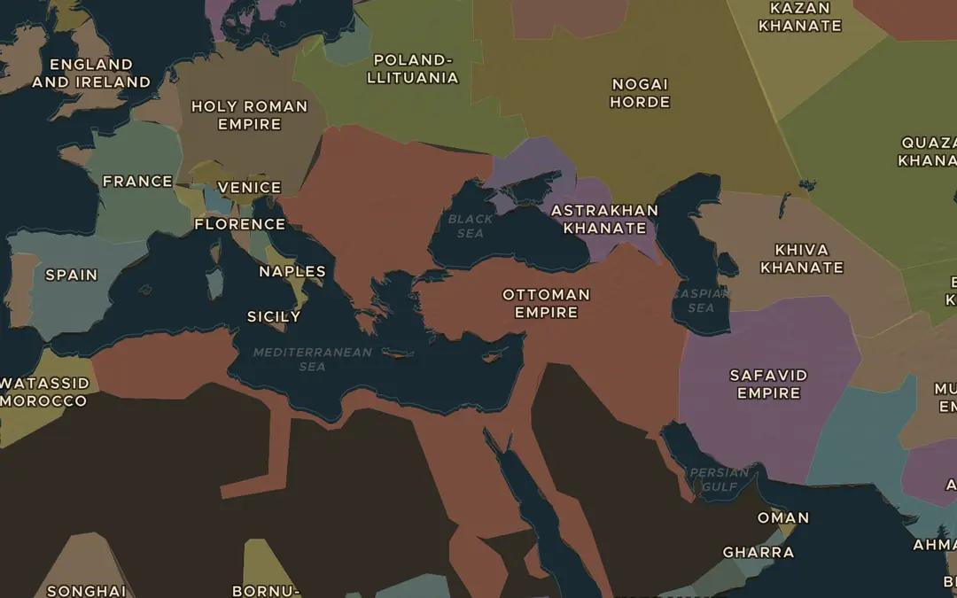
EXPLORE THE MAP · STEP A OF 3 · AD 1566
a
Three continents
Open Stories, start The Ottoman Ascent and go to "The golden age", 1566. Which seas does the empire now surround?
Open this view on the live map →
ChronoAtlas Classroom · chronoatlas.nl/classroom/lesson/suleiman-the-magnificent-and-sinan
3
Notes:
Open Stories, start The Ottoman Ascent and go to "The golden age", 1566. Which seas does the empire now surround?
https://chronoatlas.nl/?year=1566&lat=39&lng=32&zoom=3.6

Slide 4
CHRONOATLAS CLASSROOM
The rest of this deck comes with Classroom
19 more slides: the other map steps, the discussion questions, the quiz with its answers, and the worksheet.
Every lesson as a deck, every worksheet, every live lesson and homework.
€19 a month, cancel anytime. The free lesson, Rome at its height, comes whole.
https://chronoatlas.nl/pricing
ChronoAtlas Classroom · chronoatlas.nl/classroom/lesson/suleiman-the-magnificent-and-sinan
4

