Slide 1
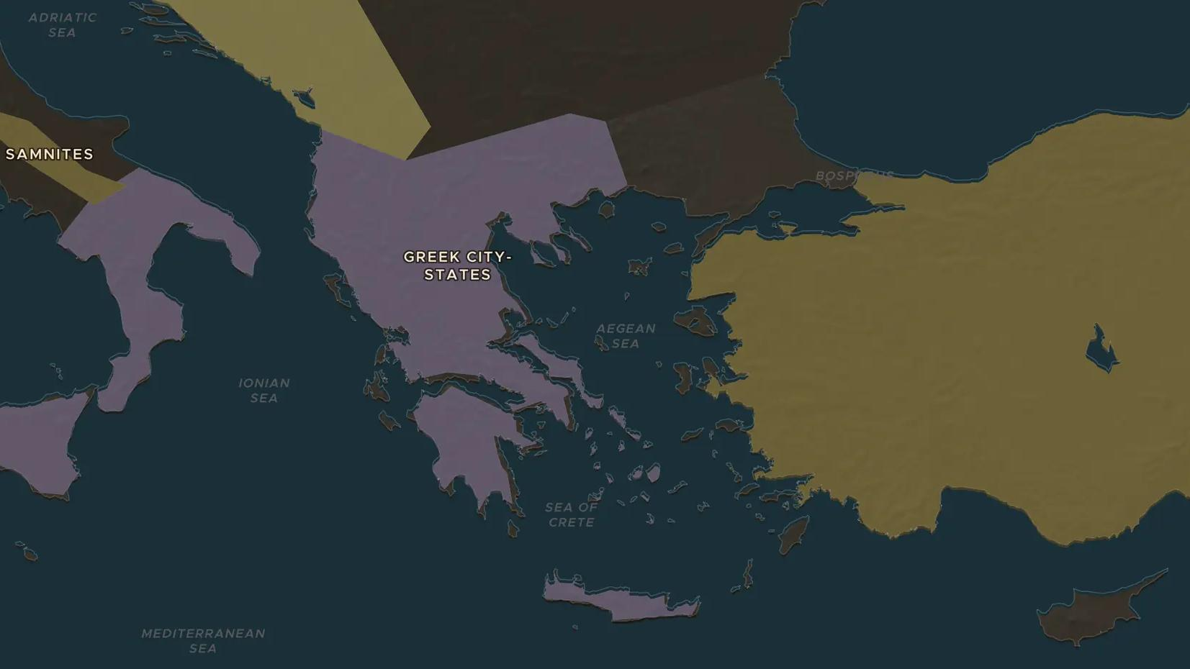
PERSIAN WARS · 480-479 BC
480 BC: Thermopylae and Salamis
ChronoAtlas Classroom · Plate 74 · Ages 11-14 · 50 min
ChronoAtlas Classroom · chronoatlas.nl/classroom/lesson/thermopylae-and-salamis

Slide 2
THIS LESSON
What students take from it
Ten years after Marathon, Xerxes brought the largest army the Greeks had ever seen across the Hellespont. Students follow it to the pass of Thermopylae, watch Athens empty its city, and see the war decided in the narrow strait of Salamis.
LENGTH
50 min
AGES
11-14
ON THE MAP
BY THE END, STUDENTS CAN
3 steps, 480 BC
Trace Xerxes's route from the Hellespont to Athens on the map.
Explain why the Greeks chose to fight at Thermopylae and at Salamis: narrow places against a bigger enemy.
Describe the outcome of 480-479 BC and what it meant for Greece and for Persia.
QUIZ
7 rounds
ChronoAtlas Classroom · chronoatlas.nl/classroom/lesson/thermopylae-and-salamis
2

Slide 3
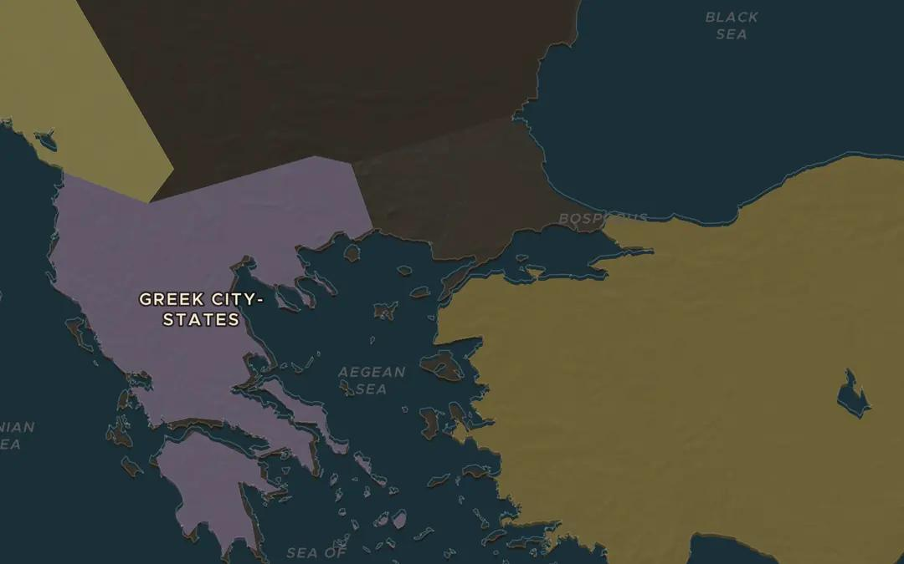
EXPLORE THE MAP · STEP A OF 3 · 480 BC
a
Crossing into Europe
Open the map in 480 BC on the Hellespont (Dardanelles). Xerxes's engineers tied hundreds of ships together to make two bridges here, and his army walked from Asia into Europe. Trace the route his army and fleet took along the coast of Thrace and Macedonia toward Greece.
Open this view on the live map →
ChronoAtlas Classroom · chronoatlas.nl/classroom/lesson/thermopylae-and-salamis
3
Notes:
Open the map in 480 BC on the Hellespont (Dardanelles). Xerxes's engineers tied hundreds of ships together to make two bridges here, and his army walked from Asia into Europe. Trace the route his army and fleet took along the coast of Thrace and Macedonia toward Greece.
https://chronoatlas.nl/?year=-480&lat=40.3&lng=26.4&zoom=6

Slide 4
CHRONOATLAS CLASSROOM
The rest of this deck comes with Classroom
19 more slides: the other map steps, the discussion questions, the quiz with its answers, and the worksheet.
Every lesson as a deck, every worksheet, every live lesson and homework.
€19 a month, cancel anytime. The free lesson, Rome at its height, comes whole.
https://chronoatlas.nl/pricing
ChronoAtlas Classroom · chronoatlas.nl/classroom/lesson/thermopylae-and-salamis
4

