Slide 1
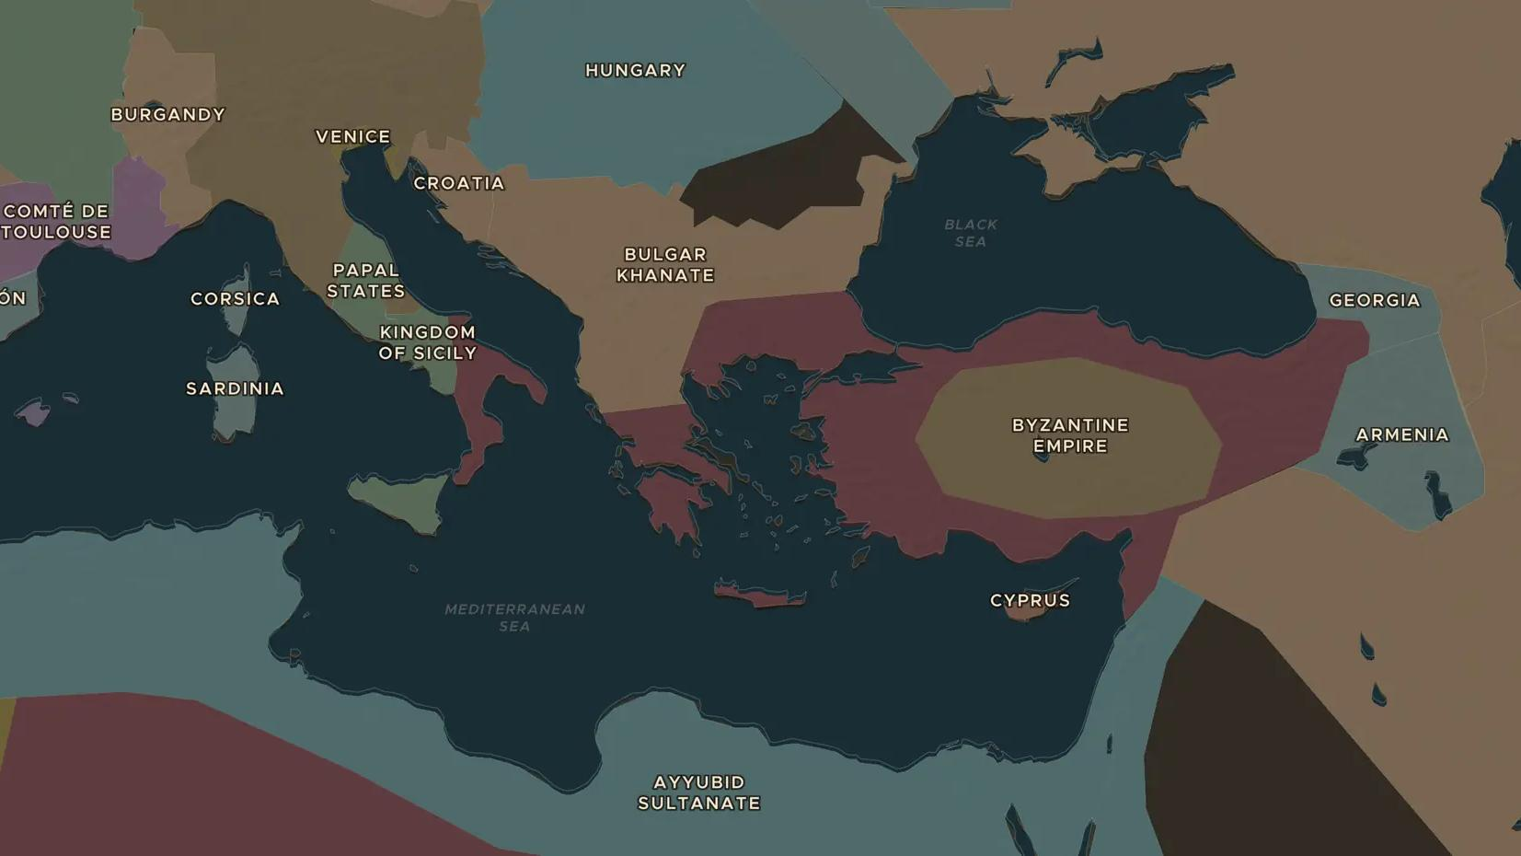
CRUSADES · 1187-1192
Richard the Lionheart and the Third Crusade
ChronoAtlas Classroom · Plate 233 · Ages 12-15 · 50 min
ChronoAtlas Classroom · chronoatlas.nl/classroom/lesson/third-crusade-richard

Slide 2
THIS LESSON
What students take from it
After Saladin takes Jerusalem in 1187, the kings of England and France and the German emperor set out to win it back. Students follow the Third Crusade by land and sea, meet Richard and Saladin through the sources, and ask why it ended in a truce.
LENGTH
50 min
AGES
12-15
ON THE MAP
BY THE END, STUDENTS CAN
3 steps, AD 1190
Explain why the Third Crusade began and who led it.
Trace the routes of the crusading armies on the map, by land and by sea.
Evaluate the Treaty of Jaffa of 1192 from the point of view of both sides.
QUIZ
7 rounds
ChronoAtlas Classroom · chronoatlas.nl/classroom/lesson/third-crusade-richard
2

Slide 3
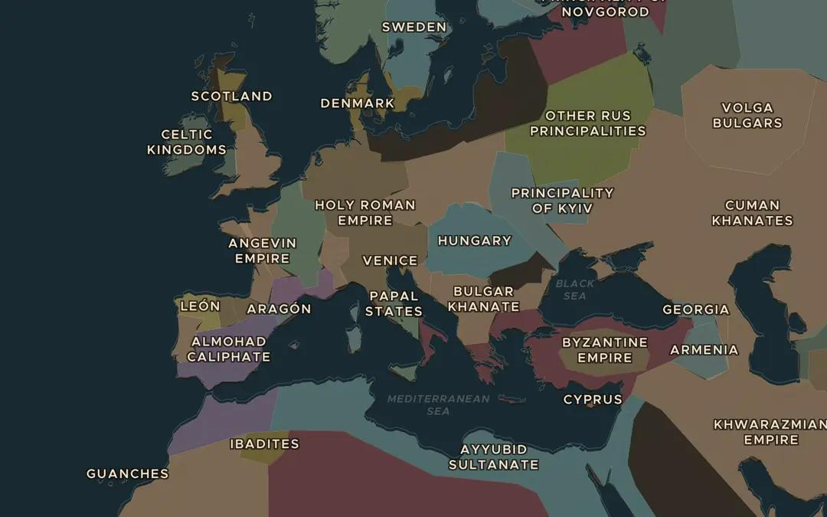
EXPLORE THE MAP · STEP A OF 3 · AD 1190
a
Three rulers set out
Open the map in 1190 and zoom out over Europe. Find the Angevin Empire, the Kingdom of France and the Holy Roman Empire. Which army had the longest road to the east?
Open this view on the live map →
ChronoAtlas Classroom · chronoatlas.nl/classroom/lesson/third-crusade-richard
3
Notes:
Open the map in 1190 and zoom out over Europe. Find the Angevin Empire, the Kingdom of France and the Holy Roman Empire. Which army had the longest road to the east?
https://chronoatlas.nl/?year=1190&lat=46&lng=15&zoom=3.6

Slide 4
CHRONOATLAS CLASSROOM
The rest of this deck comes with Classroom
19 more slides: the other map steps, the discussion questions, the quiz with its answers, and the worksheet.
Every lesson as a deck, every worksheet, every live lesson and homework.
€19 a month, cancel anytime. The free lesson, Rome at its height, comes whole.
https://chronoatlas.nl/pricing
ChronoAtlas Classroom · chronoatlas.nl/classroom/lesson/third-crusade-richard
4

