Slide 1
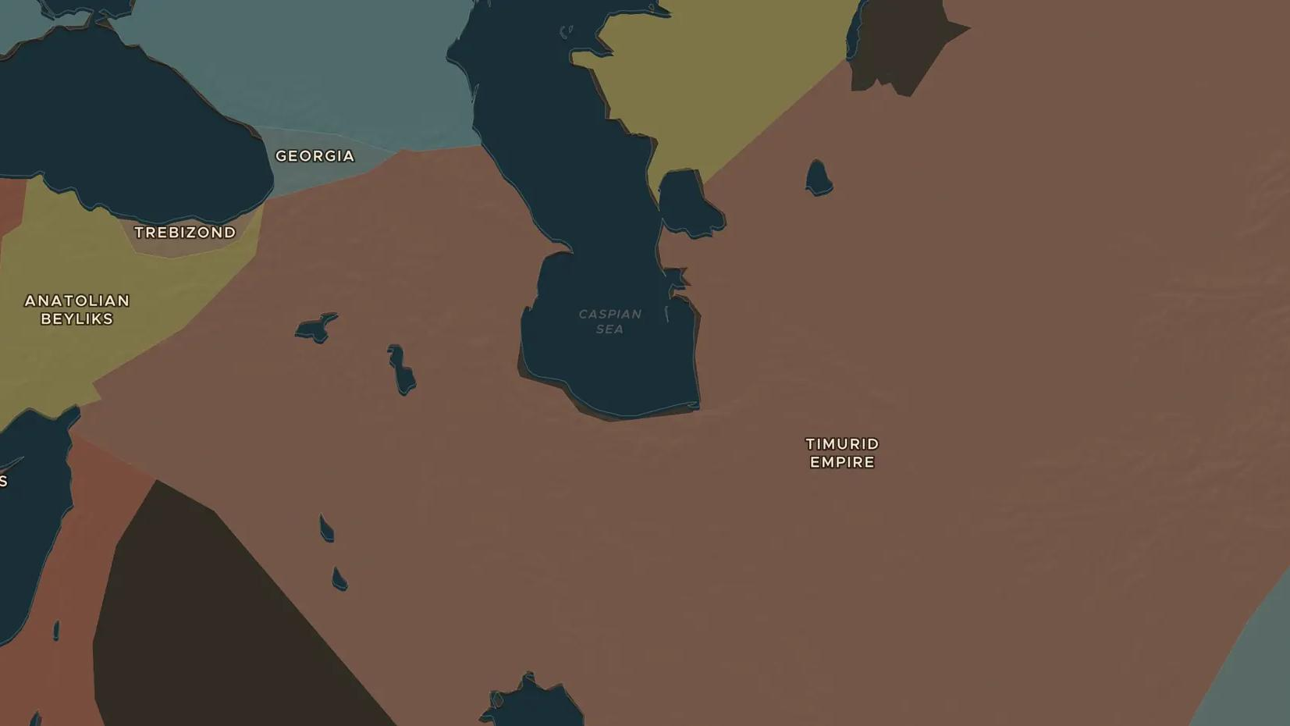
TIMURID EMPIRE · 1370-1449
Timur and the blue domes of Samarkand
ChronoAtlas Classroom · Plate 281 · Ages 12-15 · 50 min
ChronoAtlas Classroom · chronoatlas.nl/classroom/lesson/timur-and-samarkand

Slide 2
THIS LESSON
What students take from it
Timur conquered from Delhi to Ankara and filled his capital Samarkand with domes and gardens built by craftsmen from many lands. His grandson Ulugh Beg made it a city of science. Students weigh a conqueror who built one city by ruining others.
LENGTH
50 min
AGES
12-15
ON THE MAP
BY THE END, STUDENTS CAN
3 steps, AD 1400
Describe the extent of Timur's empire around 1400.
Explain how Timur used the wealth and craftsmen of conquered lands to build Samarkand.
Describe Ulugh Beg's observatory and why it mattered for science.
QUIZ
7 rounds
ChronoAtlas Classroom · chronoatlas.nl/classroom/lesson/timur-and-samarkand
2

Slide 3
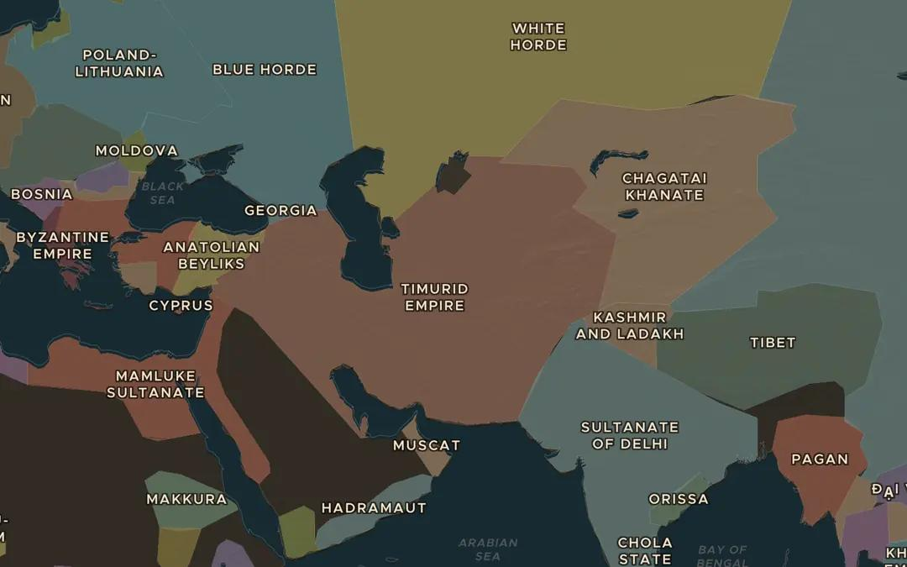
EXPLORE THE MAP · STEP A OF 3 · AD 1400
a
A conqueror's empire
Open the map in 1400 and find the Timurid Empire. Follow its border: which seas, deserts and mountain ranges mark its edges?
Open this view on the live map →
ChronoAtlas Classroom · chronoatlas.nl/classroom/lesson/timur-and-samarkand
3
Notes:
Open the map in 1400 and find the Timurid Empire. Follow its border: which seas, deserts and mountain ranges mark its edges?
https://chronoatlas.nl/?year=1400&lat=37&lng=60&zoom=3.5

Slide 4
CHRONOATLAS CLASSROOM
The rest of this deck comes with Classroom
19 more slides: the other map steps, the discussion questions, the quiz with its answers, and the worksheet.
Every lesson as a deck, every worksheet, every live lesson and homework.
€19 a month, cancel anytime. The free lesson, Rome at its height, comes whole.
https://chronoatlas.nl/pricing
ChronoAtlas Classroom · chronoatlas.nl/classroom/lesson/timur-and-samarkand
4

