Slide 1
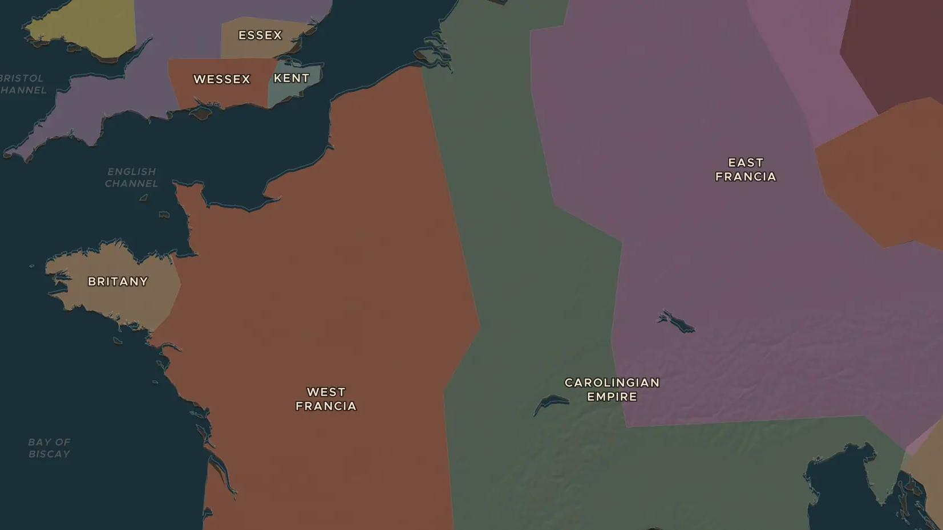
CAROLINGIAN EMPIRE · 814-888
843: one empire becomes three kingdoms
ChronoAtlas Classroom · Plate 179 · Ages 12-15 · 45 min
ChronoAtlas Classroom · chronoatlas.nl/classroom/lesson/treaty-of-verdun-843

Slide 2
THIS LESSON
What students take from it
Charlemagne's grandsons fight a civil war and then split his empire in three. Students compare the maps of 800 and 900 and trace how the Treaty of Verdun drew lines that later became France, Germany and the contested lands in between.
LENGTH
45 min
AGES
12-15
ON THE MAP
BY THE END, STUDENTS CAN
3 steps, AD 800
Explain why the Carolingian Empire was divided in 843 and who received each part.
Compare the maps of 800 and 900 and describe how the empire changed.
Explain why the lands of the middle kingdom were fought over for centuries.
QUIZ
7 rounds
ChronoAtlas Classroom · chronoatlas.nl/classroom/lesson/treaty-of-verdun-843
2

Slide 3
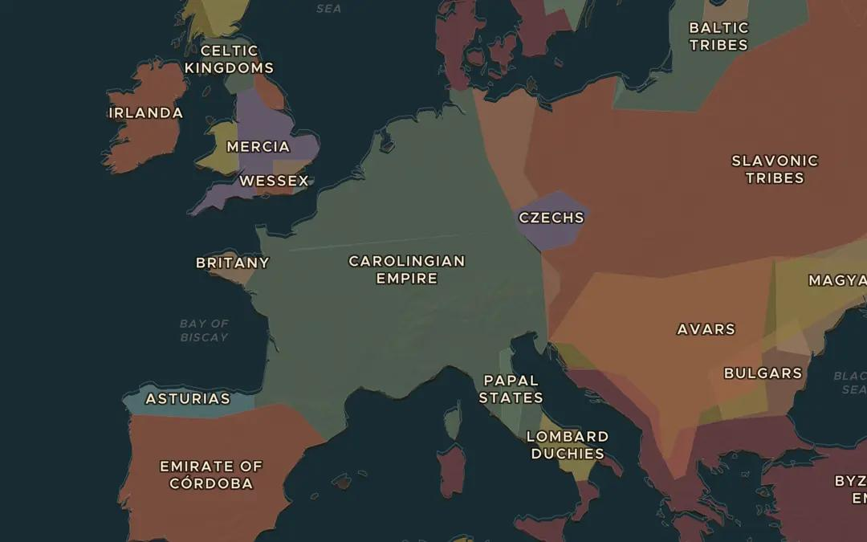
EXPLORE THE MAP · STEP A OF 3 · AD 800
a
One empire
Open the map in 800 and look at the Carolingian Empire. Note where it begins and ends. How long do you think a messenger on horseback needed to cross it?
Open this view on the live map →
ChronoAtlas Classroom · chronoatlas.nl/classroom/lesson/treaty-of-verdun-843
3
Notes:
Open the map in 800 and look at the Carolingian Empire. Note where it begins and ends. How long do you think a messenger on horseback needed to cross it?
https://chronoatlas.nl/?year=800&lat=48&lng=8&zoom=4.4

Slide 4
CHRONOATLAS CLASSROOM
The rest of this deck comes with Classroom
19 more slides: the other map steps, the discussion questions, the quiz with its answers, and the worksheet.
Every lesson as a deck, every worksheet, every live lesson and homework.
€19 a month, cancel anytime. The free lesson, Rome at its height, comes whole.
https://chronoatlas.nl/pricing
ChronoAtlas Classroom · chronoatlas.nl/classroom/lesson/treaty-of-verdun-843
4

