Slide 1
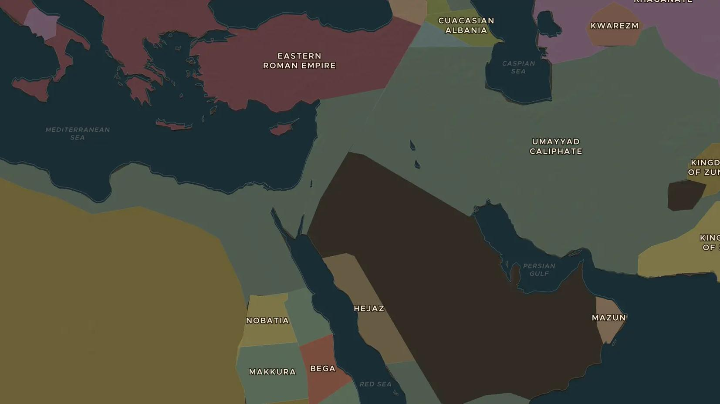
UMAYYAD CALIPHATE · 661-750
The Umayyads: an empire ruled from Damascus
ChronoAtlas Classroom · Plate 174 · Ages 12-15 · 50 min
ChronoAtlas Classroom · chronoatlas.nl/classroom/lesson/umayyad-caliphate-damascus

Slide 2
THIS LESSON
What students take from it
From Damascus, the Umayyad caliphs ruled lands from Spain to the Indus. Students explore how they held such an empire together with a capital, a common language, new coins and great buildings.
LENGTH
50 min
AGES
12-15
ON THE MAP
BY THE END, STUDENTS CAN
3 steps, AD 715
Describe the extent of the Umayyad Caliphate around 740 using the map.
Explain how Arabic, coins and buildings helped the Umayyads rule.
Give two reasons why the Umayyads fell in 750.
QUIZ
7 rounds
ChronoAtlas Classroom · chronoatlas.nl/classroom/lesson/umayyad-caliphate-damascus
2

Slide 3
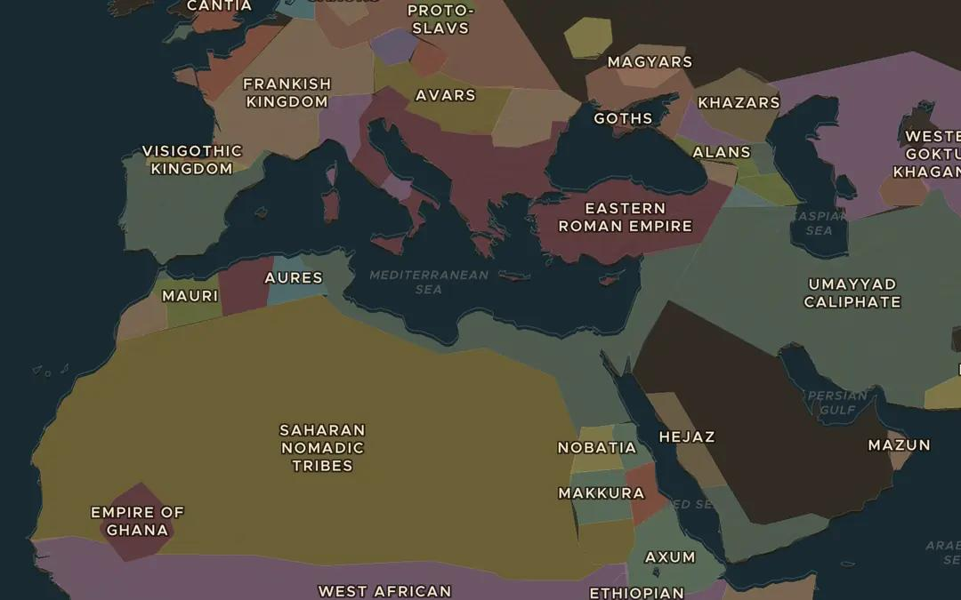
EXPLORE THE MAP · STEP A OF 3 · AD 715
a
Damascus, the capital
Open the map in 715 and turn on the Cities layer. Find Damascus and the Umayyad Caliphate around it. Which lands around the Mediterranean that once were Roman does it now hold?
Open this view on the live map →
ChronoAtlas Classroom · chronoatlas.nl/classroom/lesson/umayyad-caliphate-damascus
3
Notes:
Open the map in 715 and turn on the Cities layer. Find Damascus and the Umayyad Caliphate around it. Which lands around the Mediterranean that once were Roman does it now hold?
https://chronoatlas.nl/?year=715&lat=33.5&lng=22&zoom=3.6

Slide 4
CHRONOATLAS CLASSROOM
The rest of this deck comes with Classroom
19 more slides: the other map steps, the discussion questions, the quiz with its answers, and the worksheet.
Every lesson as a deck, every worksheet, every live lesson and homework.
€19 a month, cancel anytime. The free lesson, Rome at its height, comes whole.
https://chronoatlas.nl/pricing
ChronoAtlas Classroom · chronoatlas.nl/classroom/lesson/umayyad-caliphate-damascus
4

