Slide 1
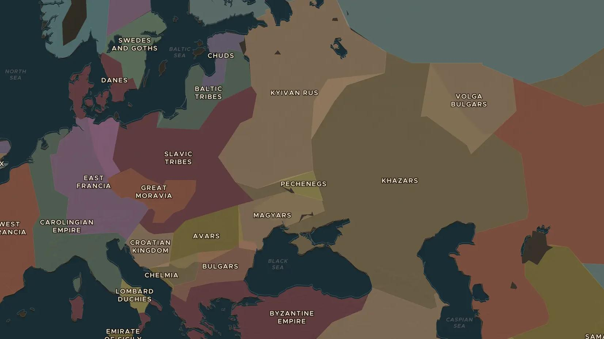
VIKING AGE · 860-1050
From the Baltic to Byzantium: the Varangians
ChronoAtlas Classroom · Plate 197 · Ages 12-15 · 50 min
ChronoAtlas Classroom · chronoatlas.nl/classroom/lesson/varangians-river-roads

Slide 2
THIS LESSON
What students take from it
Scandinavian traders row, sail and drag their boats along the rivers of eastern Europe to reach Constantinople and the markets of the Islamic world. Students follow the river roads, trace the silver and the captives that moved along them, and meet the emperor's Varangian Guard.
LENGTH
50 min
AGES
12-15
ON THE MAP
BY THE END, STUDENTS CAN
3 steps, AD 900
Trace the river route from the Baltic Sea to the Black Sea and Constantinople.
Explain what was traded along the Volga and Dnieper routes, and who paid the price.
Describe the Varangian Guard and the links it created between Scandinavia and Byzantium.
QUIZ
7 rounds
ChronoAtlas Classroom · chronoatlas.nl/classroom/lesson/varangians-river-roads
2

Slide 3
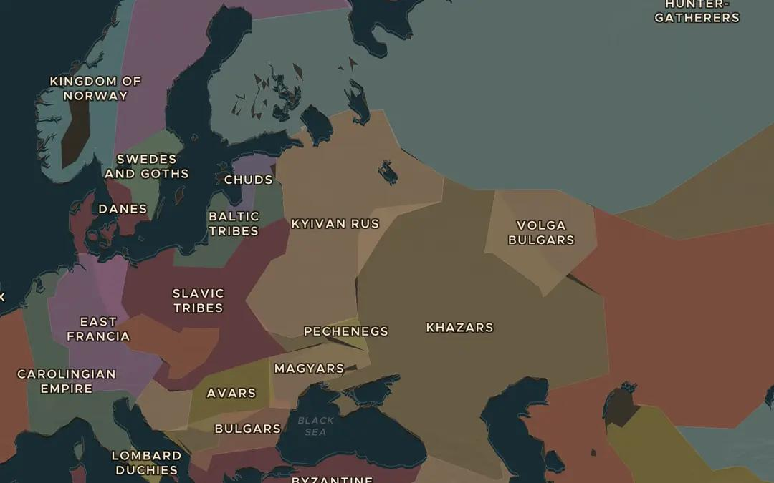
EXPLORE THE MAP · STEP A OF 3 · AD 900
a
The Volga route
Open the map in 900 and turn on Trade Routes. Follow the Volga Trade Route from the Baltic to the Caspian Sea. Which peoples and states does it pass?
Open this view on the live map →
ChronoAtlas Classroom · chronoatlas.nl/classroom/lesson/varangians-river-roads
3
Notes:
Open the map in 900 and turn on Trade Routes. Follow the Volga Trade Route from the Baltic to the Caspian Sea. Which peoples and states does it pass?
https://chronoatlas.nl/?year=900&lat=55&lng=38&zoom=3.8

Slide 4
CHRONOATLAS CLASSROOM
The rest of this deck comes with Classroom
19 more slides: the other map steps, the discussion questions, the quiz with its answers, and the worksheet.
Every lesson as a deck, every worksheet, every live lesson and homework.
€19 a month, cancel anytime. The free lesson, Rome at its height, comes whole.
https://chronoatlas.nl/pricing
ChronoAtlas Classroom · chronoatlas.nl/classroom/lesson/varangians-river-roads
4

