Slide 1
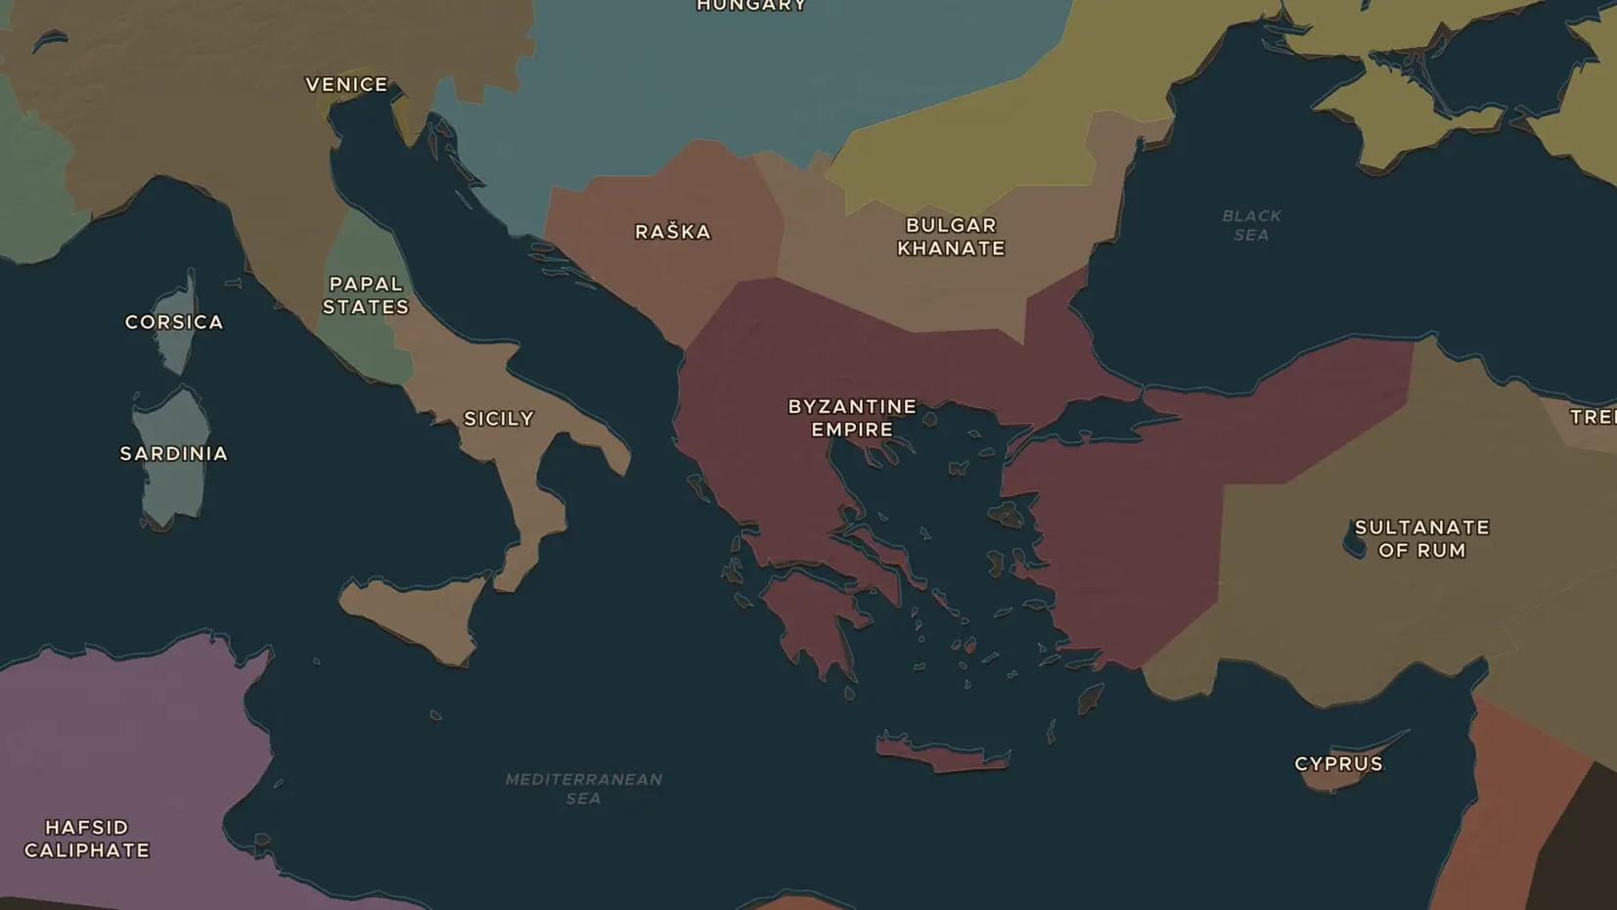
ITALIAN SEA REPUBLICS · 1100-1381
Venice and Genoa: rival sea republics
ChronoAtlas Classroom · Plate 265 · Ages 12-15 · 50 min
ChronoAtlas Classroom · chronoatlas.nl/classroom/lesson/venice-and-genoa

Slide 2
THIS LESSON
What students take from it
Two merchant republics without kings compete for the trade of the Mediterranean and the Black Sea. Students map the colonies of Venice and Genoa, follow Marco Polo from Venice, and replay the war of Chioggia that settled their long rivalry.
LENGTH
50 min
AGES
12-15
ON THE MAP
BY THE END, STUDENTS CAN
3 steps, AD 1300
Locate Venice, Genoa and their main trading colonies on the map.
Explain how a republic of merchants governed itself and built its fleets.
Describe the rivalry between Venice and Genoa and the outcome of the war of Chioggia (1378-1381).
QUIZ
7 rounds
ChronoAtlas Classroom · chronoatlas.nl/classroom/lesson/venice-and-genoa
2

Slide 3
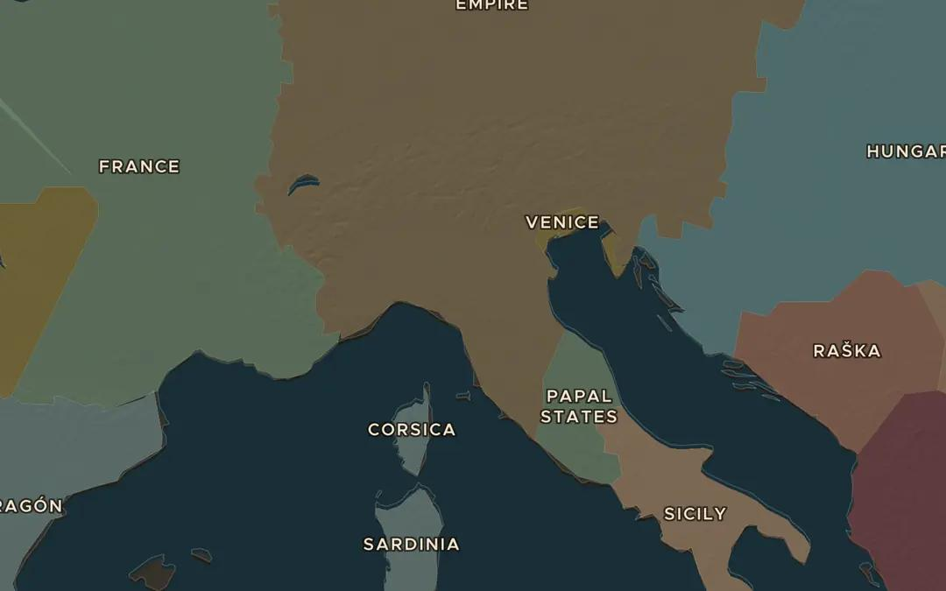
EXPLORE THE MAP · STEP A OF 3 · AD 1300
a
Two cities, two seas
Open the map in 1300 and find Venice and Genoa on either side of northern Italy. Which sea does each one face? Where would each city's ships naturally sail?
Open this view on the live map →
ChronoAtlas Classroom · chronoatlas.nl/classroom/lesson/venice-and-genoa
3
Notes:
Open the map in 1300 and find Venice and Genoa on either side of northern Italy. Which sea does each one face? Where would each city's ships naturally sail?
https://chronoatlas.nl/?year=1300&lat=44.5&lng=10.5&zoom=5.5

Slide 4
CHRONOATLAS CLASSROOM
The rest of this deck comes with Classroom
19 more slides: the other map steps, the discussion questions, the quiz with its answers, and the worksheet.
Every lesson as a deck, every worksheet, every live lesson and homework.
€19 a month, cancel anytime. The free lesson, Rome at its height, comes whole.
https://chronoatlas.nl/pricing
ChronoAtlas Classroom · chronoatlas.nl/classroom/lesson/venice-and-genoa
4

