Slide 1
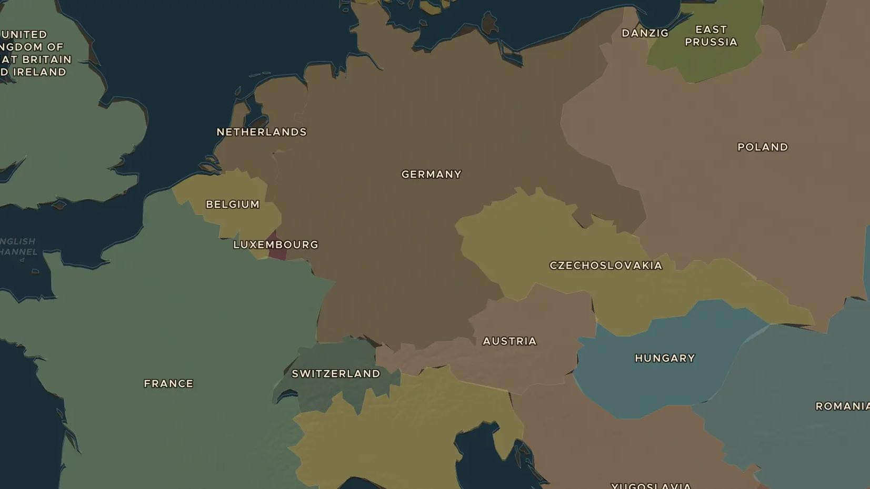
INTERWAR YEARS · 1919-1920
Versailles 1919 and the new map of Europe
ChronoAtlas Classroom · Plate 467 · Ages 12-15 · 50 min
ChronoAtlas Classroom · chronoatlas.nl/classroom/lesson/versailles-new-europe

Slide 2
THIS LESSON
What students take from it
In 1919 the winners met in Paris to make peace. Three empires had fallen, and new states filled the map from Finland to Yugoslavia. Students compare the 1914 and 1920 borders and judge whether the peacemakers built a lasting peace.
LENGTH
50 min
AGES
12-15
ON THE MAP
BY THE END, STUDENTS CAN
3 steps, AD 1920
Name the Big Three at the peace conference and what each of them wanted.
Compare the maps of 1914 and 1920 and name five new states in Europe.
Explain why many Germans saw the Treaty of Versailles as unfair.
QUIZ
7 rounds
ChronoAtlas Classroom · chronoatlas.nl/classroom/lesson/versailles-new-europe
2

Slide 3
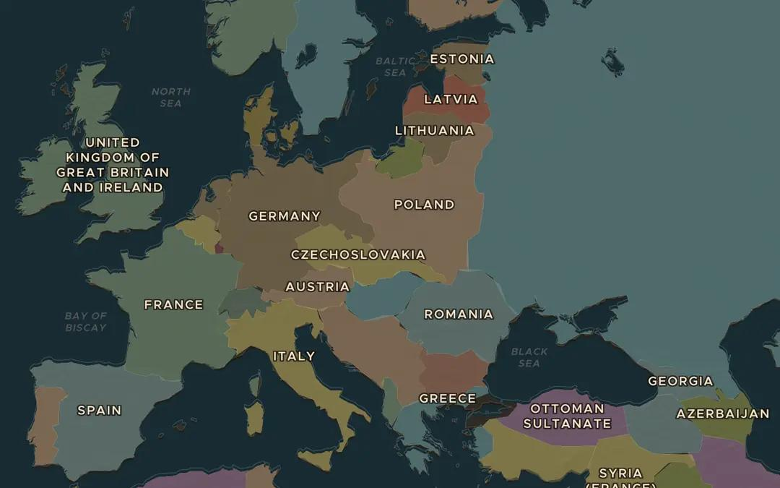
EXPLORE THE MAP · STEP A OF 3 · AD 1920
a
Before and after
Open the map in 1914, then move the slider to 1920. Watch Austria-Hungary and the western Russian Empire. Write down every new state you can find.
Open this view on the live map →
ChronoAtlas Classroom · chronoatlas.nl/classroom/lesson/versailles-new-europe
3
Notes:
Open the map in 1914, then move the slider to 1920. Watch Austria-Hungary and the western Russian Empire. Write down every new state you can find.
https://chronoatlas.nl/?year=1920&lat=50&lng=20&zoom=4

Slide 4
CHRONOATLAS CLASSROOM
The rest of this deck comes with Classroom
19 more slides: the other map steps, the discussion questions, the quiz with its answers, and the worksheet.
Every lesson as a deck, every worksheet, every live lesson and homework.
€19 a month, cancel anytime. The free lesson, Rome at its height, comes whole.
https://chronoatlas.nl/pricing
ChronoAtlas Classroom · chronoatlas.nl/classroom/lesson/versailles-new-europe
4

