Slide 1
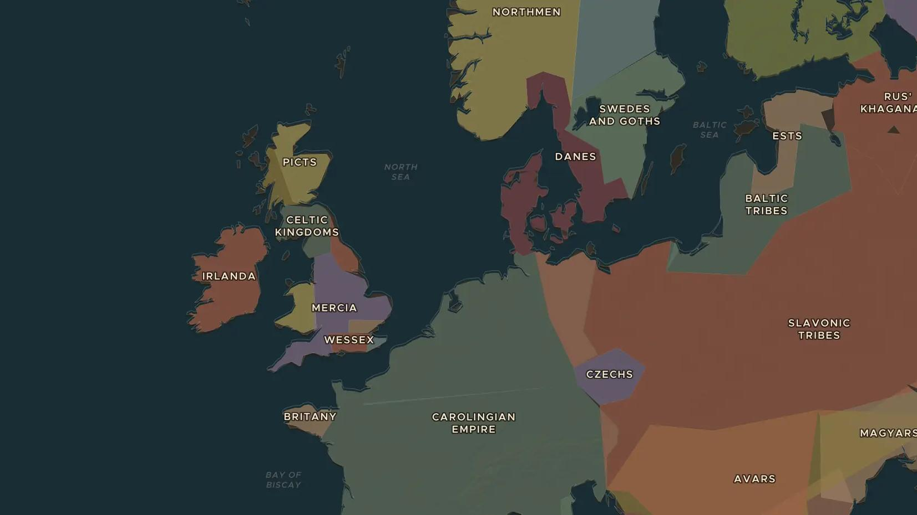
VIKING AGE · 793-900
The Viking Age begins
ChronoAtlas Classroom · Plate 191 · Ages 10-13 · 45 min
ChronoAtlas Classroom · chronoatlas.nl/classroom/lesson/viking-age-begins

Slide 2
THIS LESSON
What students take from it
In 793 raiders from the sea attack the monastery of Lindisfarne. Students meet the Vikings as raiders, traders and farmers, map their homelands and towns, and ask why they set out across the sea.
LENGTH
45 min
AGES
10-13
ON THE MAP
BY THE END, STUDENTS CAN
3 steps, AD 800
Locate the Viking homelands and three Viking-Age towns on the map.
Explain why monasteries were easy targets and why the attack on Lindisfarne shocked Christian Europe.
Describe the Vikings as farmers and traders as well as raiders, using evidence such as ships and trading towns.
QUIZ
7 rounds
ChronoAtlas Classroom · chronoatlas.nl/classroom/lesson/viking-age-begins
2

Slide 3
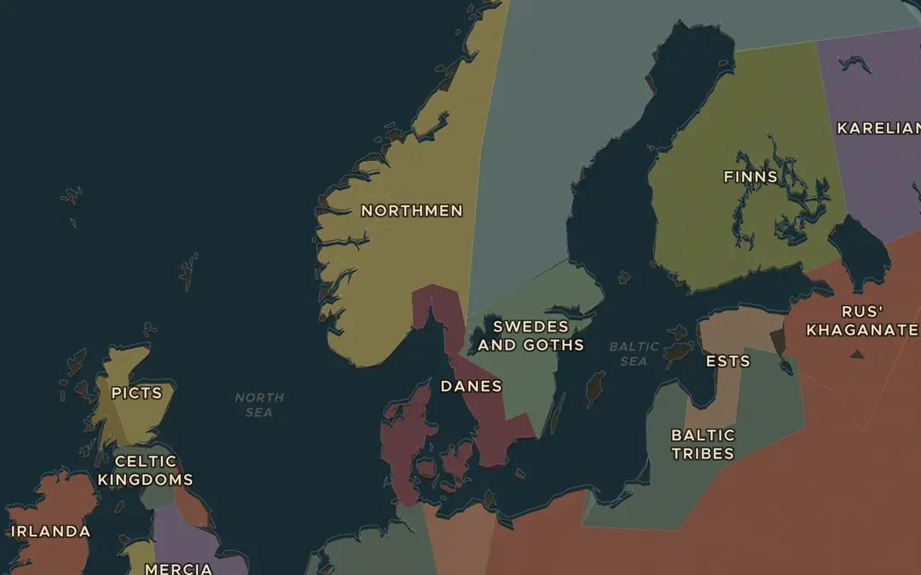
EXPLORE THE MAP · STEP A OF 3 · AD 800
a
The North in 800
Open the map in 800 on Scandinavia. Find the Danes, the Swedes and the Northmen. How much of their land lies close to the sea?
Open this view on the live map →
ChronoAtlas Classroom · chronoatlas.nl/classroom/lesson/viking-age-begins
3
Notes:
Open the map in 800 on Scandinavia. Find the Danes, the Swedes and the Northmen. How much of their land lies close to the sea?
https://chronoatlas.nl/?year=800&lat=60&lng=12&zoom=4.5

Slide 4
CHRONOATLAS CLASSROOM
The rest of this deck comes with Classroom
19 more slides: the other map steps, the discussion questions, the quiz with its answers, and the worksheet.
Every lesson as a deck, every worksheet, every live lesson and homework.
€19 a month, cancel anytime. The free lesson, Rome at its height, comes whole.
https://chronoatlas.nl/pricing
ChronoAtlas Classroom · chronoatlas.nl/classroom/lesson/viking-age-begins
4

