Slide 1
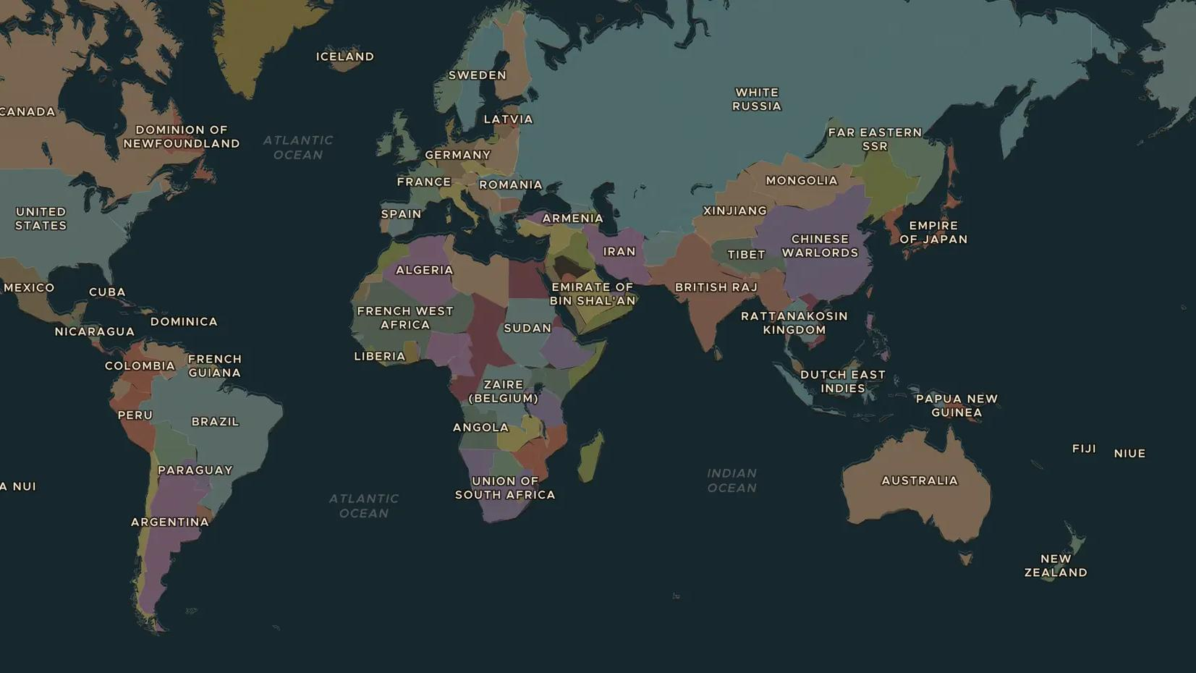
TWENTIETH CENTURY · 1918-1971
Votes for women
ChronoAtlas Classroom · Plate 465 · Ages 11-14 · 45 min
ChronoAtlas Classroom · chronoatlas.nl/classroom/lesson/votes-for-women

Slide 2
THIS LESSON
What students take from it
In 1900 women could vote in national elections almost nowhere. Within a few years of the First World War they could in much of Europe and North America, but some countries took until 1971 and later. Students map the struggle and compare the methods of campaigners.
LENGTH
45 min
AGES
11-14
ON THE MAP
BY THE END, STUDENTS CAN
3 steps, AD 1914
Explain why women campaigned for the right to vote.
Order at least five countries by the year women won the vote.
Compare different methods of campaigning, from petitions to direct action.
QUIZ
7 rounds
ChronoAtlas Classroom · chronoatlas.nl/classroom/lesson/votes-for-women
2

Slide 3
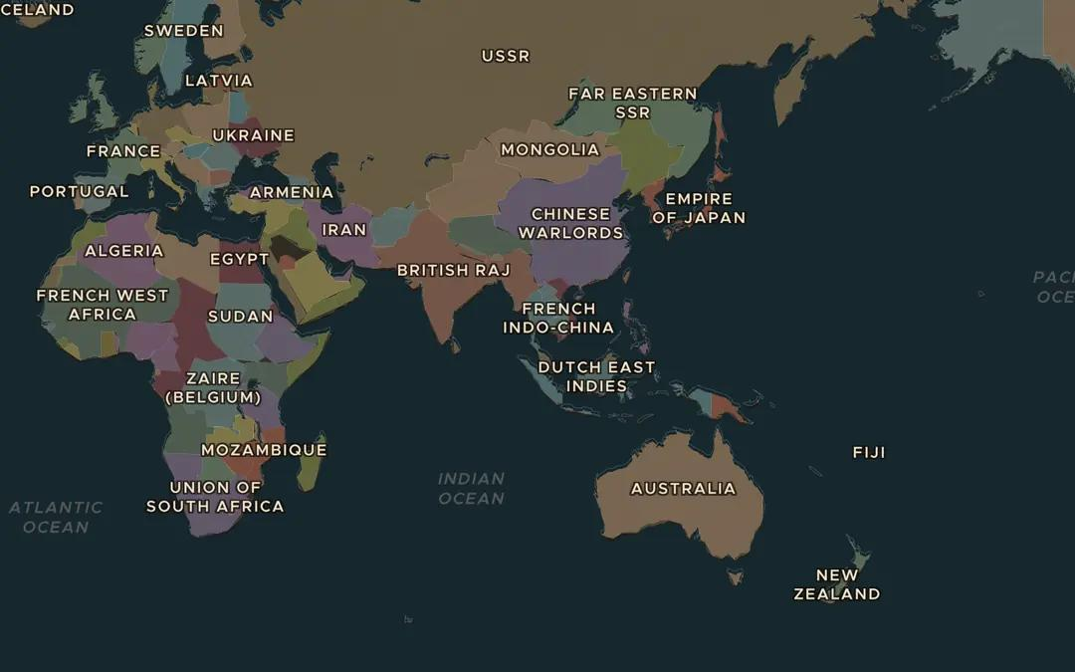
EXPLORE THE MAP · STEP A OF 3 · AD 1914
a
The first country
Open the map in 1914 and zoom out to find New Zealand. In 1893 it became the first self-governing country where women could vote in national elections. Then find Finland, the first in Europe in 1906.
Open this view on the live map →
ChronoAtlas Classroom · chronoatlas.nl/classroom/lesson/votes-for-women
3
Notes:
Open the map in 1914 and zoom out to find New Zealand. In 1893 it became the first self-governing country where women could vote in national elections. Then find Finland, the first in Europe in 1906.
https://chronoatlas.nl/?year=1914&lat=10&lng=100&zoom=2

Slide 4
CHRONOATLAS CLASSROOM
The rest of this deck comes with Classroom
19 more slides: the other map steps, the discussion questions, the quiz with its answers, and the worksheet.
Every lesson as a deck, every worksheet, every live lesson and homework.
€19 a month, cancel anytime. The free lesson, Rome at its height, comes whole.
https://chronoatlas.nl/pricing
ChronoAtlas Classroom · chronoatlas.nl/classroom/lesson/votes-for-women
4

