Slide 1
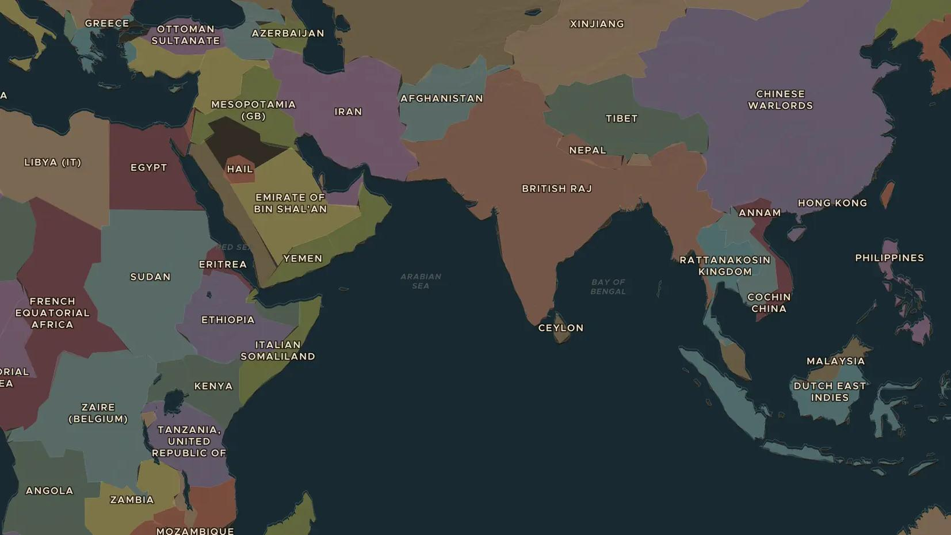
FIRST WORLD WAR · 1914-1918
A world war: Africa, Asia and the Middle East
ChronoAtlas Classroom · Plate 459 · Ages 12-15 · 50 min
ChronoAtlas Classroom · chronoatlas.nl/classroom/lesson/ww1-a-world-war

Slide 2
THIS LESSON
What students take from it
The First World War was not only fought in Europe. African soldiers and carriers fought in East Africa, Japan seized a German port in China and Arab forces rose against Ottoman rule. Students follow the war across the 1914 map of empires.
LENGTH
50 min
AGES
12-15
ON THE MAP
BY THE END, STUDENTS CAN
3 steps, AD 1914
Name three places outside Europe where the First World War was fought.
Explain why colonial empires turned a European war into a world war.
Describe the role of soldiers and carriers from Africa and Asia.
QUIZ
7 rounds
ChronoAtlas Classroom · chronoatlas.nl/classroom/lesson/ww1-a-world-war
2

Slide 3
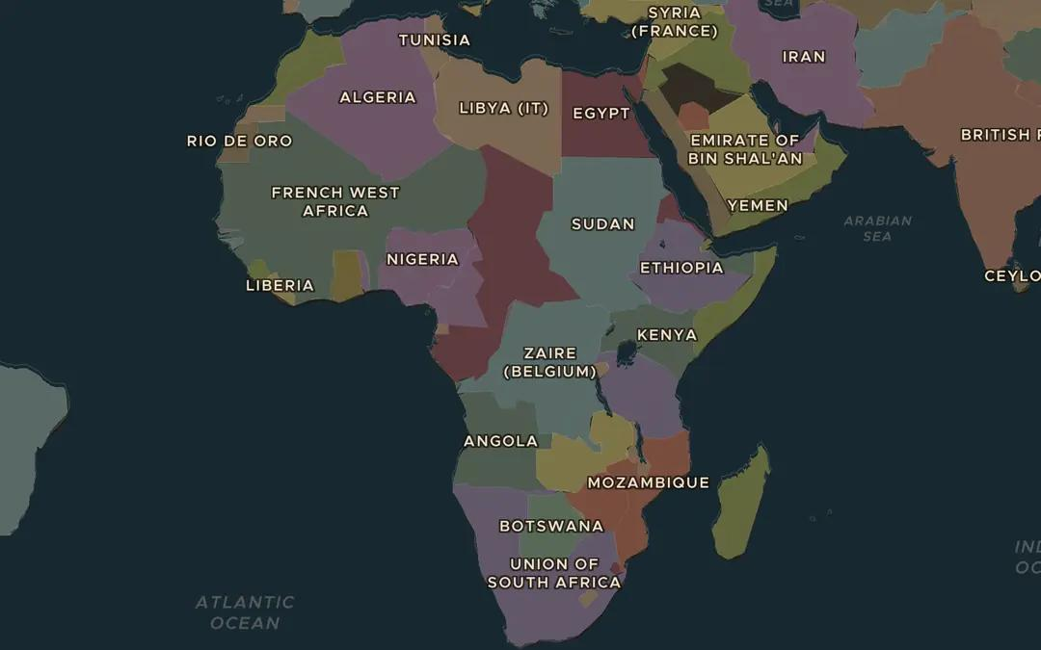
EXPLORE THE MAP · STEP A OF 3 · AD 1914
a
Empires in 1914
Open the map in 1914 and zoom out over Africa. Find the colonies of Britain, France and Germany. Where do German and Allied colonies share a border?
Open this view on the live map →
ChronoAtlas Classroom · chronoatlas.nl/classroom/lesson/ww1-a-world-war
3
Notes:
Open the map in 1914 and zoom out over Africa. Find the colonies of Britain, France and Germany. Where do German and Allied colonies share a border?
https://chronoatlas.nl/?year=1914&lat=2&lng=20&zoom=3

Slide 4
CHRONOATLAS CLASSROOM
The rest of this deck comes with Classroom
19 more slides: the other map steps, the discussion questions, the quiz with its answers, and the worksheet.
Every lesson as a deck, every worksheet, every live lesson and homework.
€19 a month, cancel anytime. The free lesson, Rome at its height, comes whole.
https://chronoatlas.nl/pricing
ChronoAtlas Classroom · chronoatlas.nl/classroom/lesson/ww1-a-world-war
4

