Slide 1
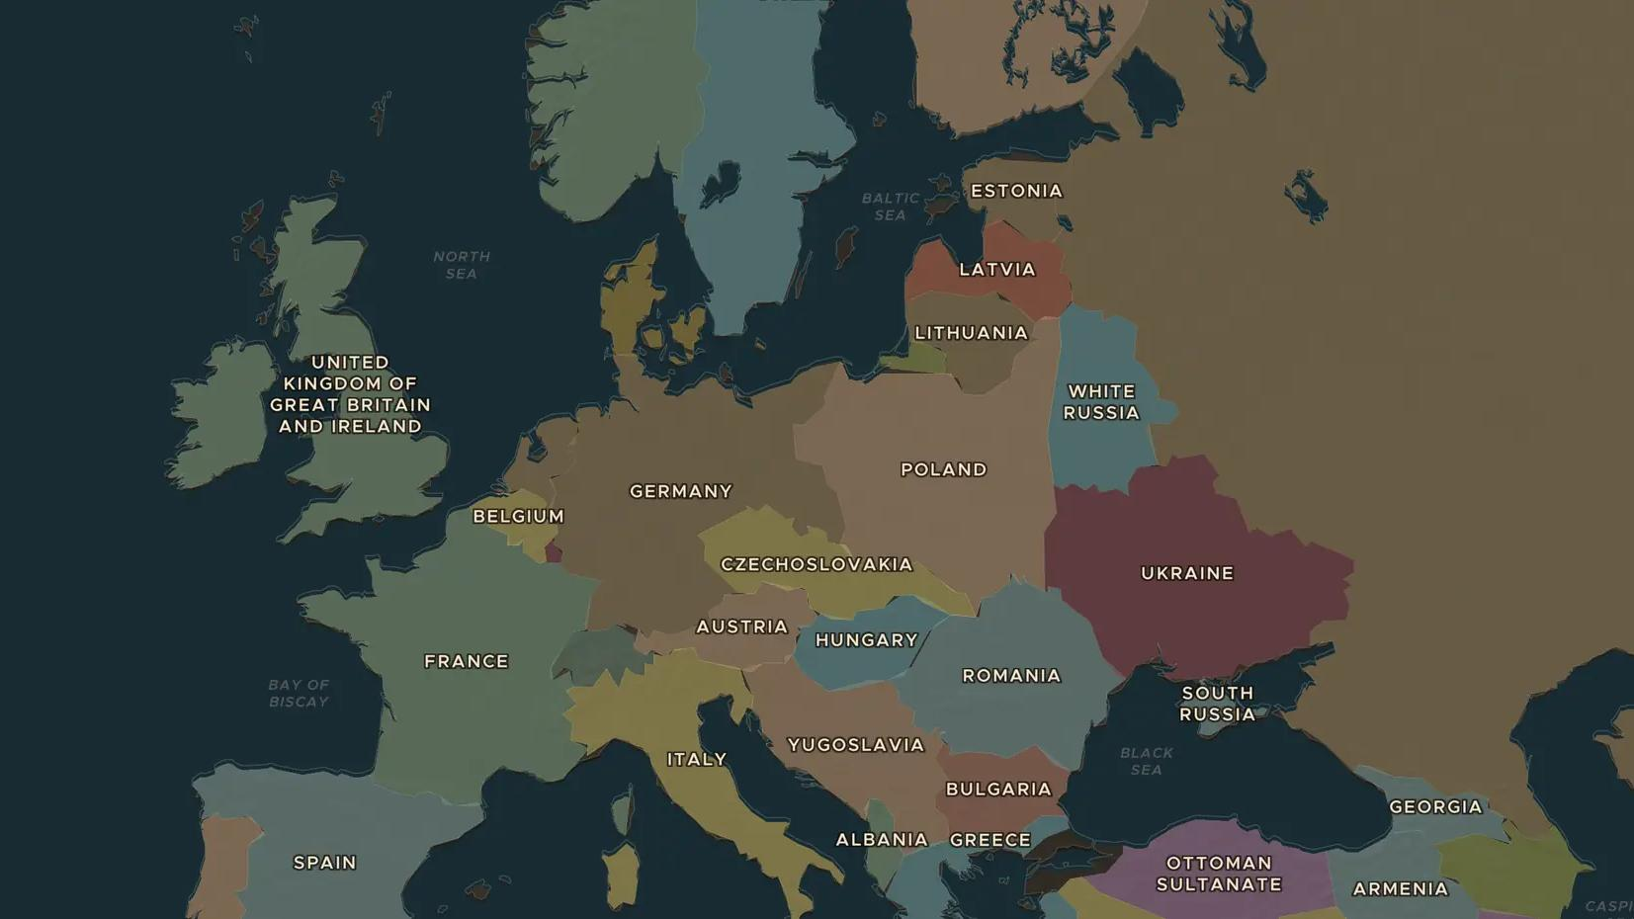
FIRST WORLD WAR · 1914
1914: how Europe went to war
ChronoAtlas Classroom · Plate 456 · Ages 12-15 · 50 min
ChronoAtlas Classroom · chronoatlas.nl/classroom/lesson/ww1-outbreak-1914

Slide 2
THIS LESSON
What students take from it
On 28 June 1914 two shots in Sarajevo set off a chain reaction. Within six weeks the great powers of Europe were at war. Students trace the alliances on the 1914 map and ask why one murder became a world war.
LENGTH
50 min
AGES
12-15
ON THE MAP
BY THE END, STUDENTS CAN
3 steps, AD 1914
Explain how the murder in Sarajevo on 28 June 1914 led to a European war within six weeks.
Show on the 1914 map the two alliance blocs and at least two neutral countries.
Weigh at least two causes of the war, such as alliances, militarism, empire and nationalism.
QUIZ
7 rounds
ChronoAtlas Classroom · chronoatlas.nl/classroom/lesson/ww1-outbreak-1914
2

Slide 3
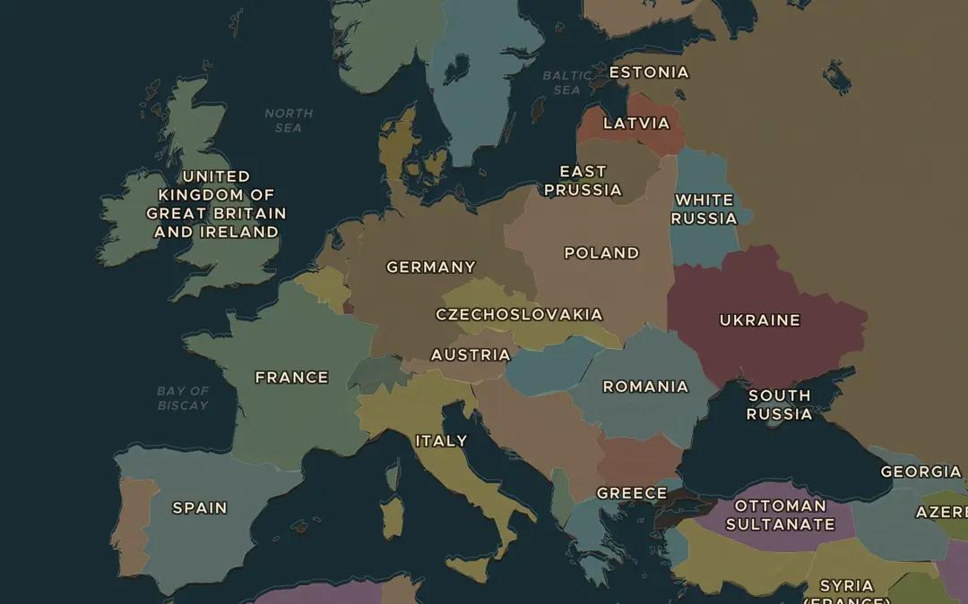
EXPLORE THE MAP · STEP A OF 3 · AD 1914
a
Europe in 1914
Open the map in 1914. Find the German Empire, Austria-Hungary, Russia and France. Which countries surround Germany and Austria-Hungary? Why might their leaders feel encircled?
Open this view on the live map →
ChronoAtlas Classroom · chronoatlas.nl/classroom/lesson/ww1-outbreak-1914
3
Notes:
Open the map in 1914. Find the German Empire, Austria-Hungary, Russia and France. Which countries surround Germany and Austria-Hungary? Why might their leaders feel encircled?
https://chronoatlas.nl/?year=1914&lat=50&lng=15&zoom=4

Slide 4
CHRONOATLAS CLASSROOM
The rest of this deck comes with Classroom
19 more slides: the other map steps, the discussion questions, the quiz with its answers, and the worksheet.
Every lesson as a deck, every worksheet, every live lesson and homework.
€19 a month, cancel anytime. The free lesson, Rome at its height, comes whole.
https://chronoatlas.nl/pricing
ChronoAtlas Classroom · chronoatlas.nl/classroom/lesson/ww1-outbreak-1914
4

