Slide 1
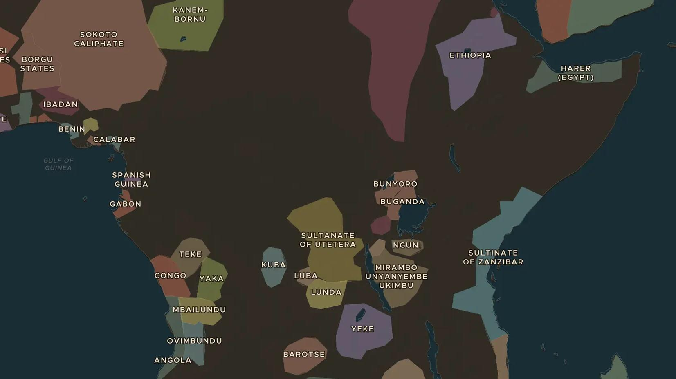
ASANTE RESISTANCE · 1900
Yaa Asantewaa and the War of the Golden Stool
ChronoAtlas Classroom · Plate 452 · Ages 11-14 · 45 min
ChronoAtlas Classroom · chronoatlas.nl/classroom/lesson/yaa-asantewaa-war-1900

Slide 2
THIS LESSON
What students take from it
In 1900 a British governor demanded the sacred Golden Stool of the Asante. Yaa Asantewaa, queen mother of Ejisu, led the rising that followed. Students find out why the Asante lost the war but kept the stool.
LENGTH
45 min
AGES
11-14
ON THE MAP
BY THE END, STUDENTS CAN
3 steps, AD 1900
Locate Kumasi and Ejisu and explain the meaning of the Golden Stool.
Describe the causes and main events of the War of the Golden Stool in 1900.
Explain why Yaa Asantewaa is remembered as a national heroine in Ghana.
QUIZ
7 rounds
ChronoAtlas Classroom · chronoatlas.nl/classroom/lesson/yaa-asantewaa-war-1900
2

Slide 3
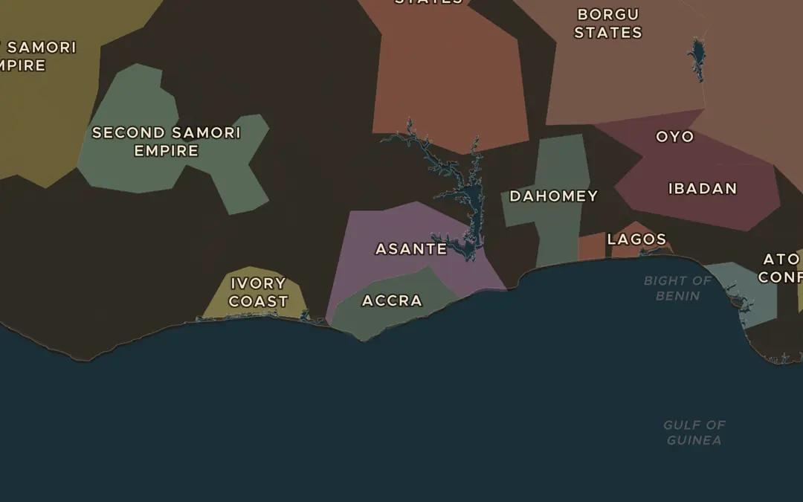
EXPLORE THE MAP · STEP A OF 3 · AD 1900
a
Asante in 1900
Open the map in 1900 and find Asante. Which labels lie between Asante and the sea?
Open this view on the live map →
ChronoAtlas Classroom · chronoatlas.nl/classroom/lesson/yaa-asantewaa-war-1900
3
Notes:
Open the map in 1900 and find Asante. Which labels lie between Asante and the sea?
https://chronoatlas.nl/?year=1900&lat=6.5&lng=-1.3&zoom=6

Slide 4
CHRONOATLAS CLASSROOM
The rest of this deck comes with Classroom
19 more slides: the other map steps, the discussion questions, the quiz with its answers, and the worksheet.
Every lesson as a deck, every worksheet, every live lesson and homework.
€19 a month, cancel anytime. The free lesson, Rome at its height, comes whole.
https://chronoatlas.nl/pricing
ChronoAtlas Classroom · chronoatlas.nl/classroom/lesson/yaa-asantewaa-war-1900
4

