Slide 1
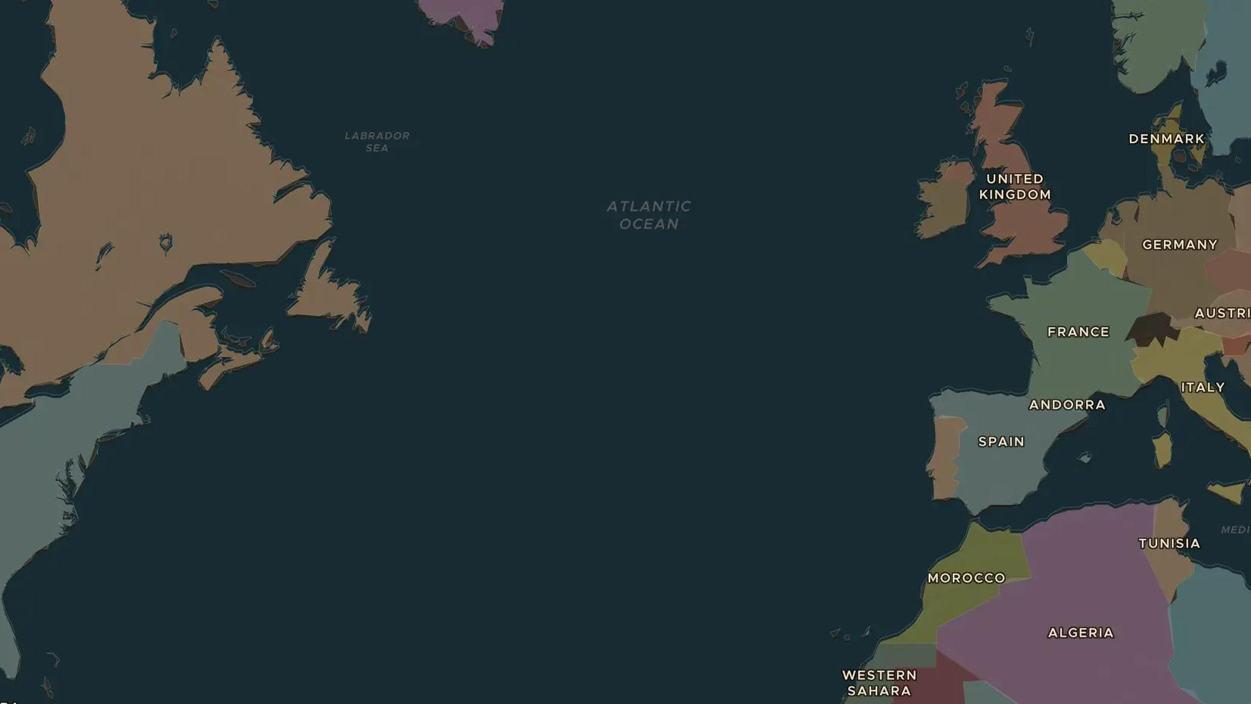
POST-COLD WAR · 1991-1999
The wars in Yugoslavia, 1991-1999
ChronoAtlas Classroom · Plate 514 · Ages 13-16 · 50 min
ChronoAtlas Classroom · chronoatlas.nl/classroom/lesson/yugoslav-wars

Slide 2
THIS LESSON
What students take from it
After Tito's death, Yugoslavia broke apart. Slovenia left after ten days; Croatia and Bosnia saw years of war, the siege of Sarajevo and the genocide at Srebrenica. Students compare the 1960 and 1994 maps and ask how neighbors became enemies and how the wars were stopped.
LENGTH
50 min
AGES
13-16
ON THE MAP
BY THE END, STUDENTS CAN
3 steps, AD 1994
Explain why Yugoslavia broke apart after 1990.
Locate Slovenia, Croatia, Bosnia and Herzegovina, Serbia and Kosovo on the 1994 map.
Describe how the war in Bosnia ended at Dayton and how the International Criminal Tribunal in The Hague judged the crimes.
QUIZ
7 rounds
ChronoAtlas Classroom · chronoatlas.nl/classroom/lesson/yugoslav-wars
2

Slide 3
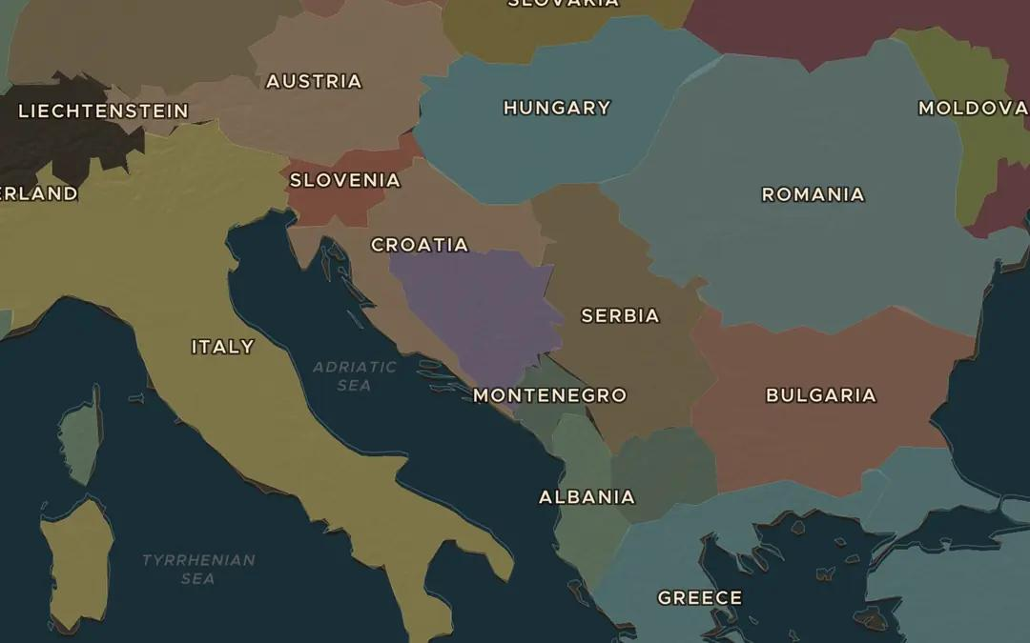
EXPLORE THE MAP · STEP A OF 3 · AD 1994
a
One country, many peoples
Open the map in 1960 and find Yugoslavia. Then move to 1994. Which new countries do you see? Ask the atlas: "Which peoples lived in Yugoslavia?"
Open this view on the live map →
ChronoAtlas Classroom · chronoatlas.nl/classroom/lesson/yugoslav-wars
3
Notes:
Open the map in 1960 and find Yugoslavia. Then move to 1994. Which new countries do you see? Ask the atlas: "Which peoples lived in Yugoslavia?"
https://chronoatlas.nl/?year=1994&lat=44&lng=18.5&zoom=5.5

Slide 4
CHRONOATLAS CLASSROOM
The rest of this deck comes with Classroom
19 more slides: the other map steps, the discussion questions, the quiz with its answers, and the worksheet.
Every lesson as a deck, every worksheet, every live lesson and homework.
€19 a month, cancel anytime. The free lesson, Rome at its height, comes whole.
https://chronoatlas.nl/pricing
ChronoAtlas Classroom · chronoatlas.nl/classroom/lesson/yugoslav-wars
4

