Slide 1
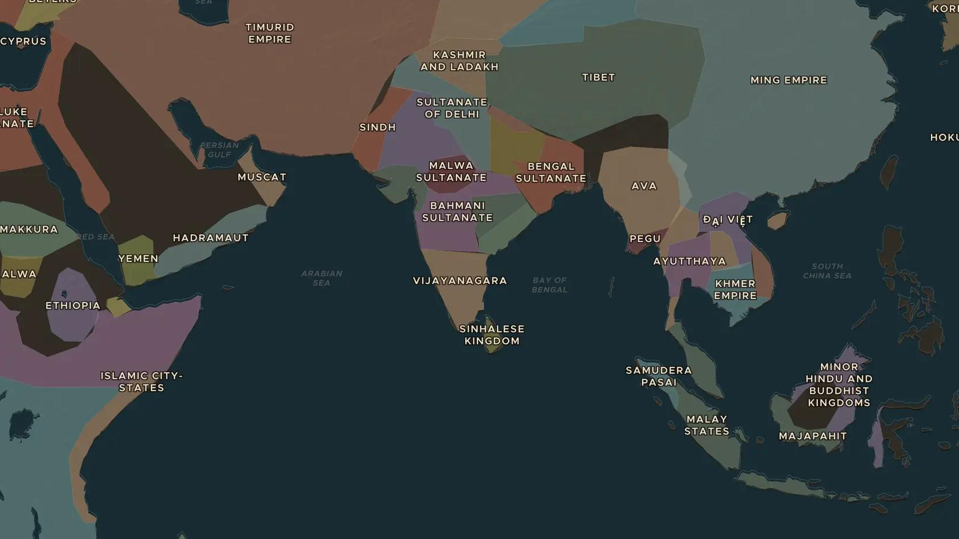
MING DYNASTY · 1405-1433
Zheng He's treasure fleets
ChronoAtlas Classroom · Plate 282 · Ages 10-13 · 50 min
ChronoAtlas Classroom · chronoatlas.nl/classroom/lesson/zheng-he-treasure-fleets

Slide 2
THIS LESSON
What students take from it
Between 1405 and 1433 the admiral Zheng He led seven huge Ming fleets across the Indian Ocean, as far as Arabia and East Africa. Students follow the voyages on the map and ask why China then turned its back on the sea.
LENGTH
50 min
AGES
10-13
ON THE MAP
BY THE END, STUDENTS CAN
3 steps, AD 1405
Trace the routes of Zheng He's voyages on the map, from Nanjing to East Africa.
Explain the aims of the voyages: power, trade and tribute.
Discuss why the Ming ended the voyages after 1433.
QUIZ
7 rounds
ChronoAtlas Classroom · chronoatlas.nl/classroom/lesson/zheng-he-treasure-fleets
2

Slide 3
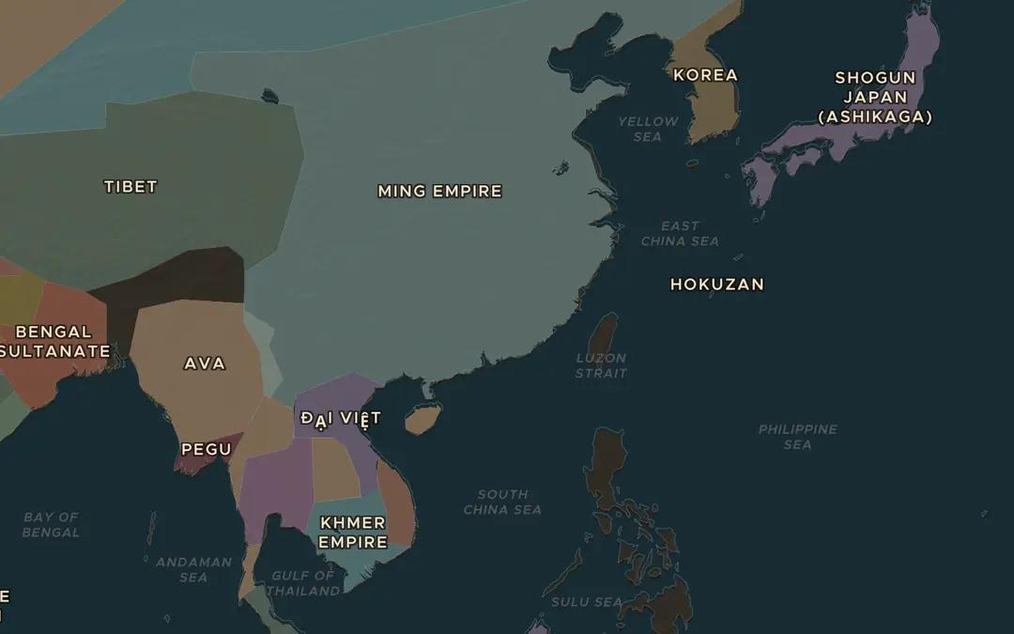
EXPLORE THE MAP · STEP A OF 3 · AD 1405
a
Setting sail
Open the map in 1405 and find Nanjing on the Yangtze, where the treasure ships were built. Follow the coast south. Which sea would the fleet cross to reach Southeast Asia?
Open this view on the live map →
ChronoAtlas Classroom · chronoatlas.nl/classroom/lesson/zheng-he-treasure-fleets
3
Notes:
Open the map in 1405 and find Nanjing on the Yangtze, where the treasure ships were built. Follow the coast south. Which sea would the fleet cross to reach Southeast Asia?
https://chronoatlas.nl/?year=1405&lat=25&lng=115&zoom=4

Slide 4
CHRONOATLAS CLASSROOM
The rest of this deck comes with Classroom
19 more slides: the other map steps, the discussion questions, the quiz with its answers, and the worksheet.
Every lesson as a deck, every worksheet, every live lesson and homework.
€19 a month, cancel anytime. The free lesson, Rome at its height, comes whole.
https://chronoatlas.nl/pricing
ChronoAtlas Classroom · chronoatlas.nl/classroom/lesson/zheng-he-treasure-fleets
4

